Slide 1
Grand Rounds
Your Name
Date of Presentation

Slide 2

Welcome & Introduction
Meet the Presenter
        Insert Name
        Title
        Credentials
        Other Information
Check out our Practice
  Name of practice
  Address
  Address continued
  Other (e.g., list of services)
Notes:
Change AUGS logo on bottom right to say “advancing urogynecology and reconstructive pelvic surgery” instead of FPMRS

Slide 3
Objectives
Introduction to the URPS Subspecialty
  What We Treat &Who We Work With
Urinary Incontinence
Pelvic Organ Prolapse
When To Refer And How We Can Help
Resources For Physicians And Patients
Questions and Answers
Diagnosis
Workup
Treatment
Review the Evidence

Slide 4
What is “URPS”?
Urogynecology and Reconstructive Pelvic Surgery
  “Urogynecology” or “Female Urology”
Subspecialty of either OB/GYN or Urology that provides comprehensive care for Pelvic Floor Disorders
Certified by the American Board of Medical Specialties
  ACGME residency in OBGYN or Urology
  ACGME fellowship in URPS
  Pass a written/oral board examination

Slide 5
What is the URPS Scope of Practice?
We are trained in the evaluation, diagnosis, management and treatment of female pelvic floor disorders.
We are trained in the performance and interpretation of a wide range of laboratory, radiographic and interventional studies.
  Ex. urodynamic testing, cystoscopy, anorectal manometry, endoanal ultrasound
  We formulate individualized plans that utilize medical, behavioral, non-surgical or surgical treatment options.
  We promote women’s pelvic floor health through research and education.
AUGS 2016 Policy Statement for the FPMRS scope of practice
Notes:
The Following 2 slides also come from the AUGS 2016 policy statement on FPMRS scope of practice

Slide 6
Areas of Expertise
Pelvic floor anatomy and physiology
Pathophysiology of pelvic floor disorders
  Urinary
    Incontinence, recurrent UTI, bladder pain, urethral diverticula, voiding dysfunction, neurogenic bladder
  Defecatory
    Fecal incontinence and defecatory dysfunction
  Vaginal
    Pelvic organ prolapse, obstetric birth trauma, vesico-vaginal and rectovaginal fistulae, complications of pelvic floor surgeries, mesh complications, pelvic/vulvar pain disorders

Slide 7

Who We Work With
Gynecology
Urology
Gastroenterology and Colorectal
Surgery
Pelvic Floor Physical Therapy
Multi-disciplinary group
(ambulatory or inpatient/surgical settings)
Notes:
Opportunity to discuss your combined clinics/ pelvic floor centers

Slide 8
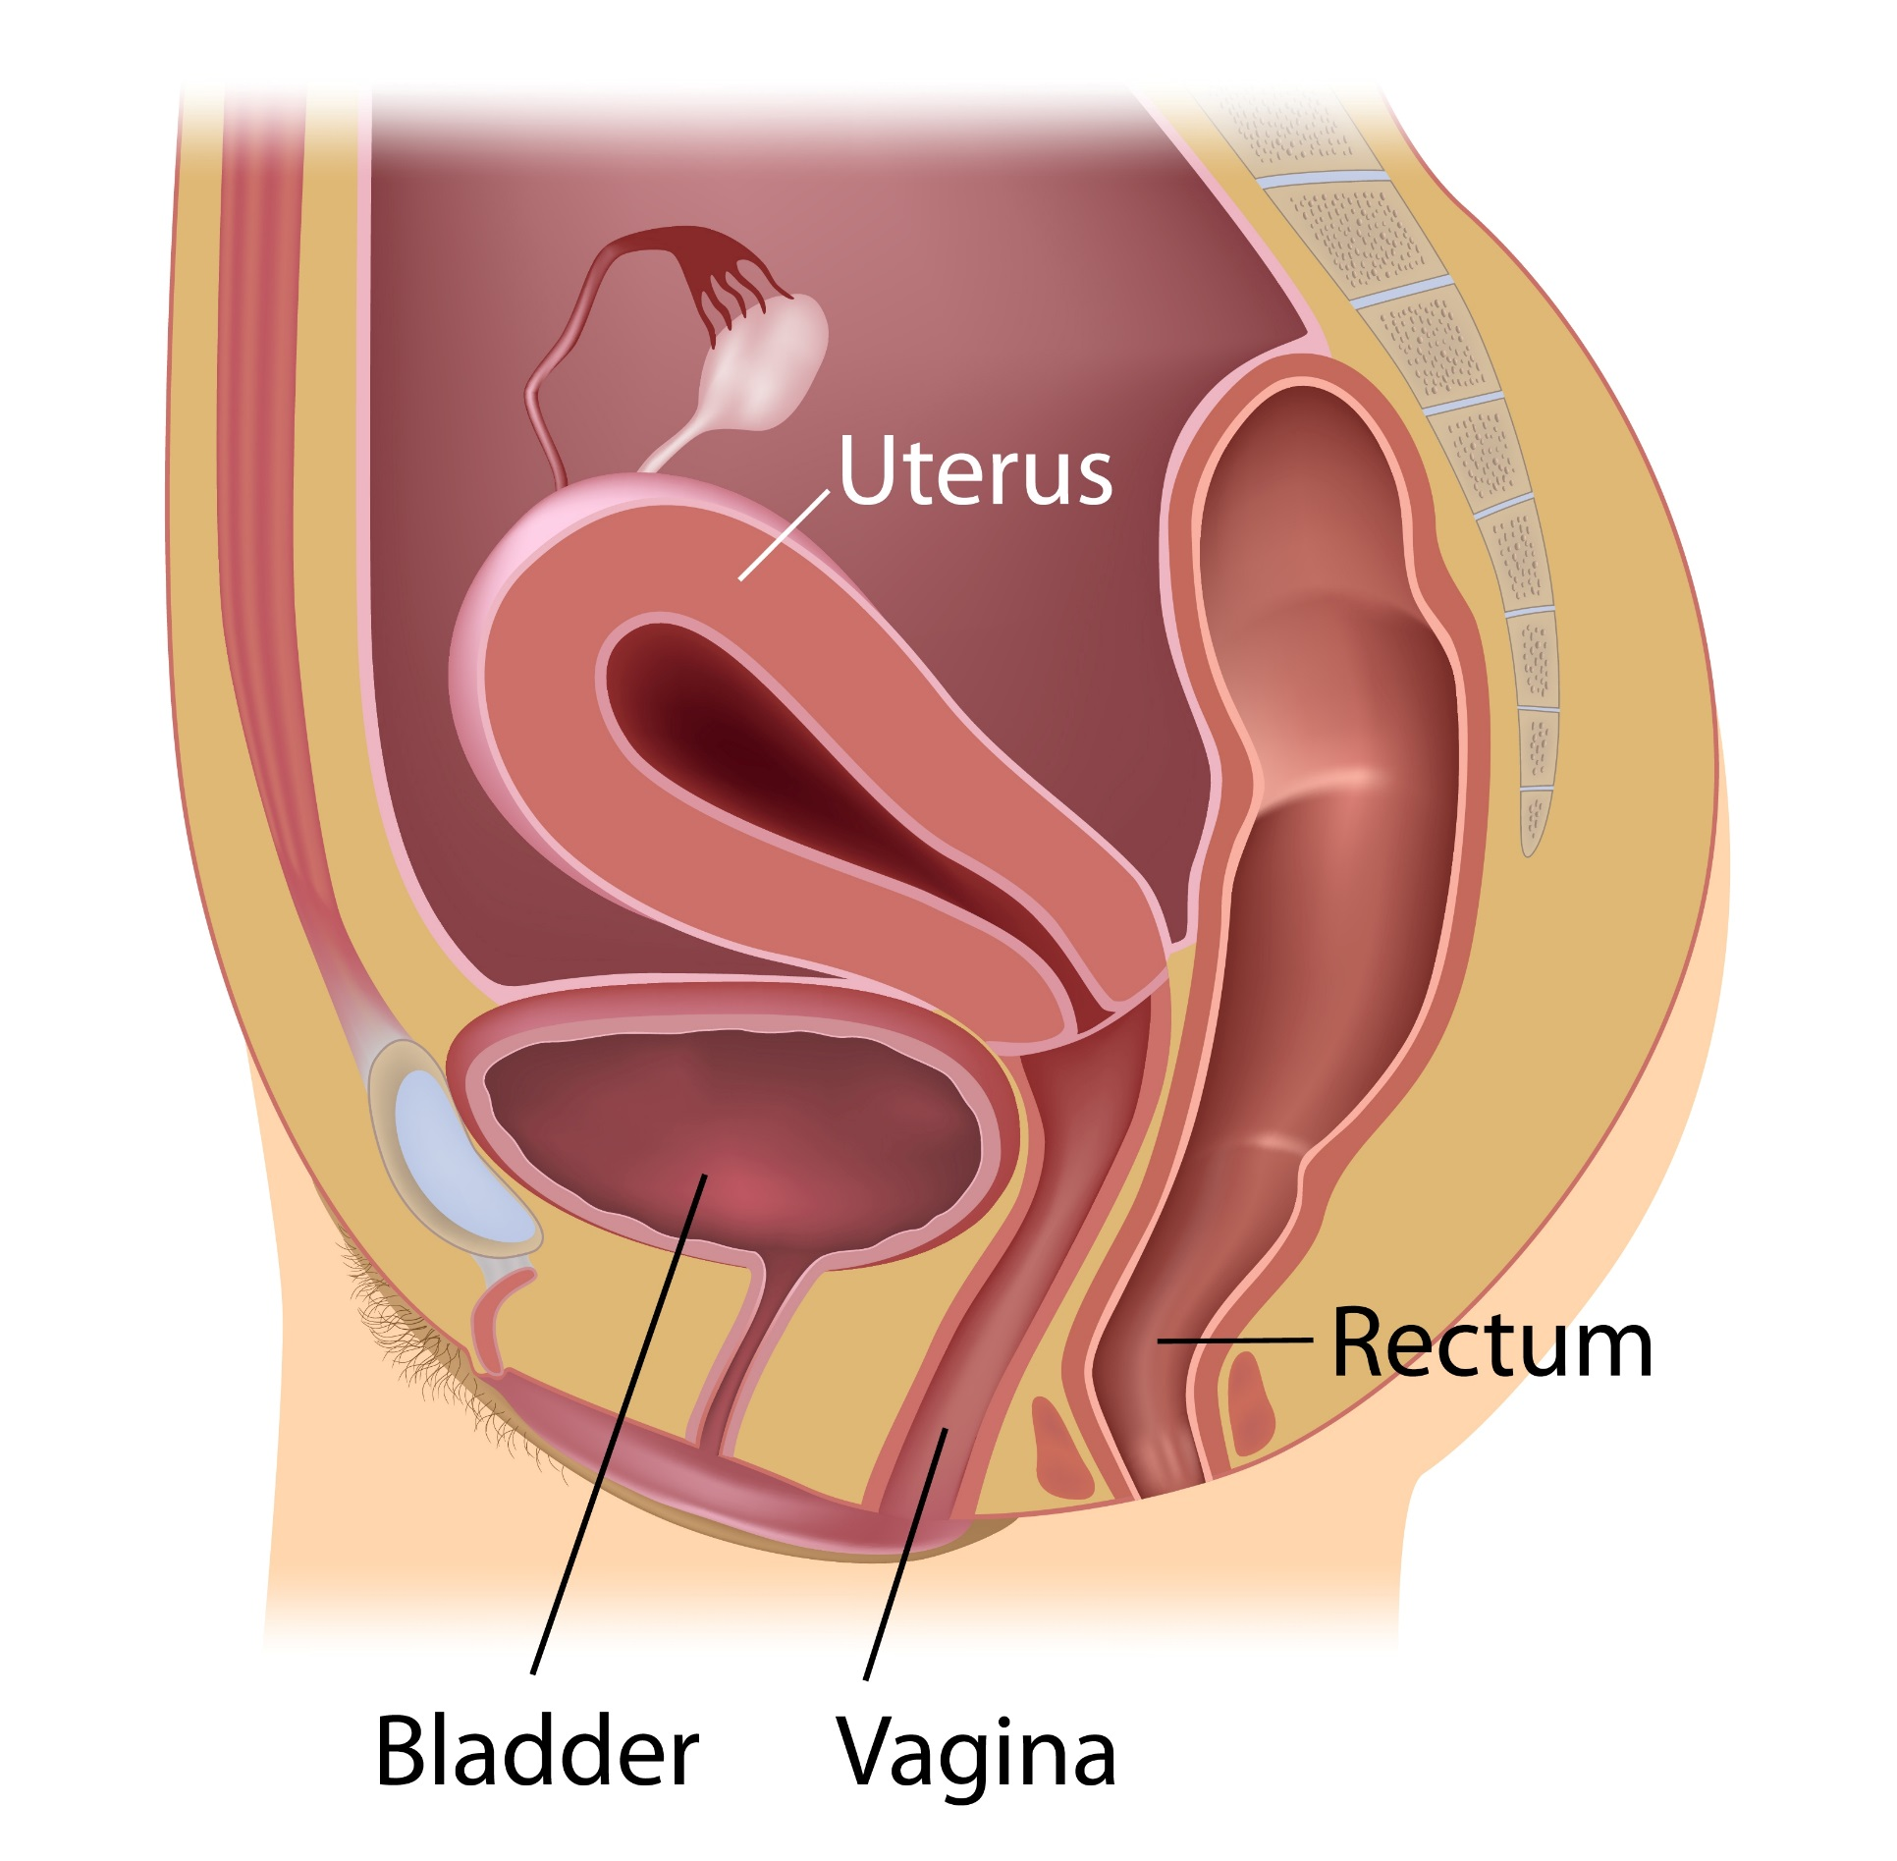
What is the “Pelvic Floor”?
Set of muscles, ligaments, and connective tissue
Supports and controls function of
the pelvic organs:
  Bladder
  Uterus
  Rectum
  Vagina
Pelvic floor

Slide 9

“POP” Quiz
As a woman, your chance of getting a pelvic floor disorder (PFD) is:
  1 in 3
  1 in 8
  1 in 15

Slide 10
Intro to Pelvic Floor Disorders
About 1:3 women will experience a PFD in her lifetime and 1:9 will have surgery for a PFD

Slide 11
PFDs You May See…
Urinary Incontinence
Pelvic Organ Prolapse
Potpourri: Fecal Incontinence, Obstetric Trauma, Fistulas, Vulvar Dystrophies
Notes:
These are the most common referrals and what we will cover today

Slide 12
Care Seeking in Urinary Incontinence
26% of women wait over 5 years to seek help
33% wait 1 to 5 years
41% seek help within 1 year
Norton, P A et al. BMJ, 1988

Slide 13
Symptoms of Urinary Incontinence
Leaking with laughing, coughing, sneezing, lifting, exercise
"Gotta go, gotta go” and don’t make it on time
Waking up wetting the bed at night
Slow or interrupted urine stream or sense of incomplete bladder emptying
Sexual problems, e.g., urgency or leaking urine with sexual activity

Slide 14
UI—Common Types
STRESS INCONTINENCE
URGE INCONTINENCE Overactive Bladder
OTHER TYPES
  Urine leaks with activities
  Coughing, sneezing, laughing, lifting, exercising
  Urgency (with or without leakage)
  Frequency
  Nocturia
  Mixed incontinence
  “Wet all the time”
  Insensible
  Functional (cognitive or physical impairment)
Notes:
Differential of leakage may also include non-UI diagnoses such as fistulae, congenital (ectopic ureter, epispadias), medications

Slide 15
Stress Urinary Incontinence (SUI)

Slide 16
SUI - Definition
International Continence Society:
  “The observation of involuntary leakage from the urethra, synchronous with exertion/effort, or on sneezing or coughing.”
  Classified as urodynamic SUI: “the involuntary leakage of urine during increased abdominal pressure, in the absence of a detrusor contraction”
  “Intrinsic Sphincter Deficiency (ISD)”
Physiology
  Urine leakage associated with increased abdominal pressure that gets transmitted to the bladder, which cannot be overcome by urethral pressure/resistance
Notes:
International Continence Society: Standardization of Terminology of Lower Urinary Tract Dysfunction

Slide 17
Risk Factors
Childbirth (Parity)
  Vaginal vs. Cesarean Section
  Instrumented Delivery
Aging
High BMI
COPD
Prior pelvic surgery
Family history

Slide 18
Evaluation - History
HPI
When do you leak?
  With cough, sneeze, exercise?
  With strong urge?
  Are you worried about leaking just getting to the bathroom?
How much? Drops vs. Full Bladder?
Do you have to wear pads?
How often do you urinate?
  Are you emptying your bladder completely?
  Do you dribble or leak right after you voided?
Pain? Blood? Recurrent UTI?

Slide 19
Evaluation - History
Medical History
  Diabetes (neuropathy)
  Stroke
  Lumbar Disc Disease
  MS/Parkinson’s/CVA
Obstetrical History
  Use of forceps, size of babies, hours in 2nd stage of labor
Surgical History
  Pelvic surgery
  Radiation therapy

Slide 20
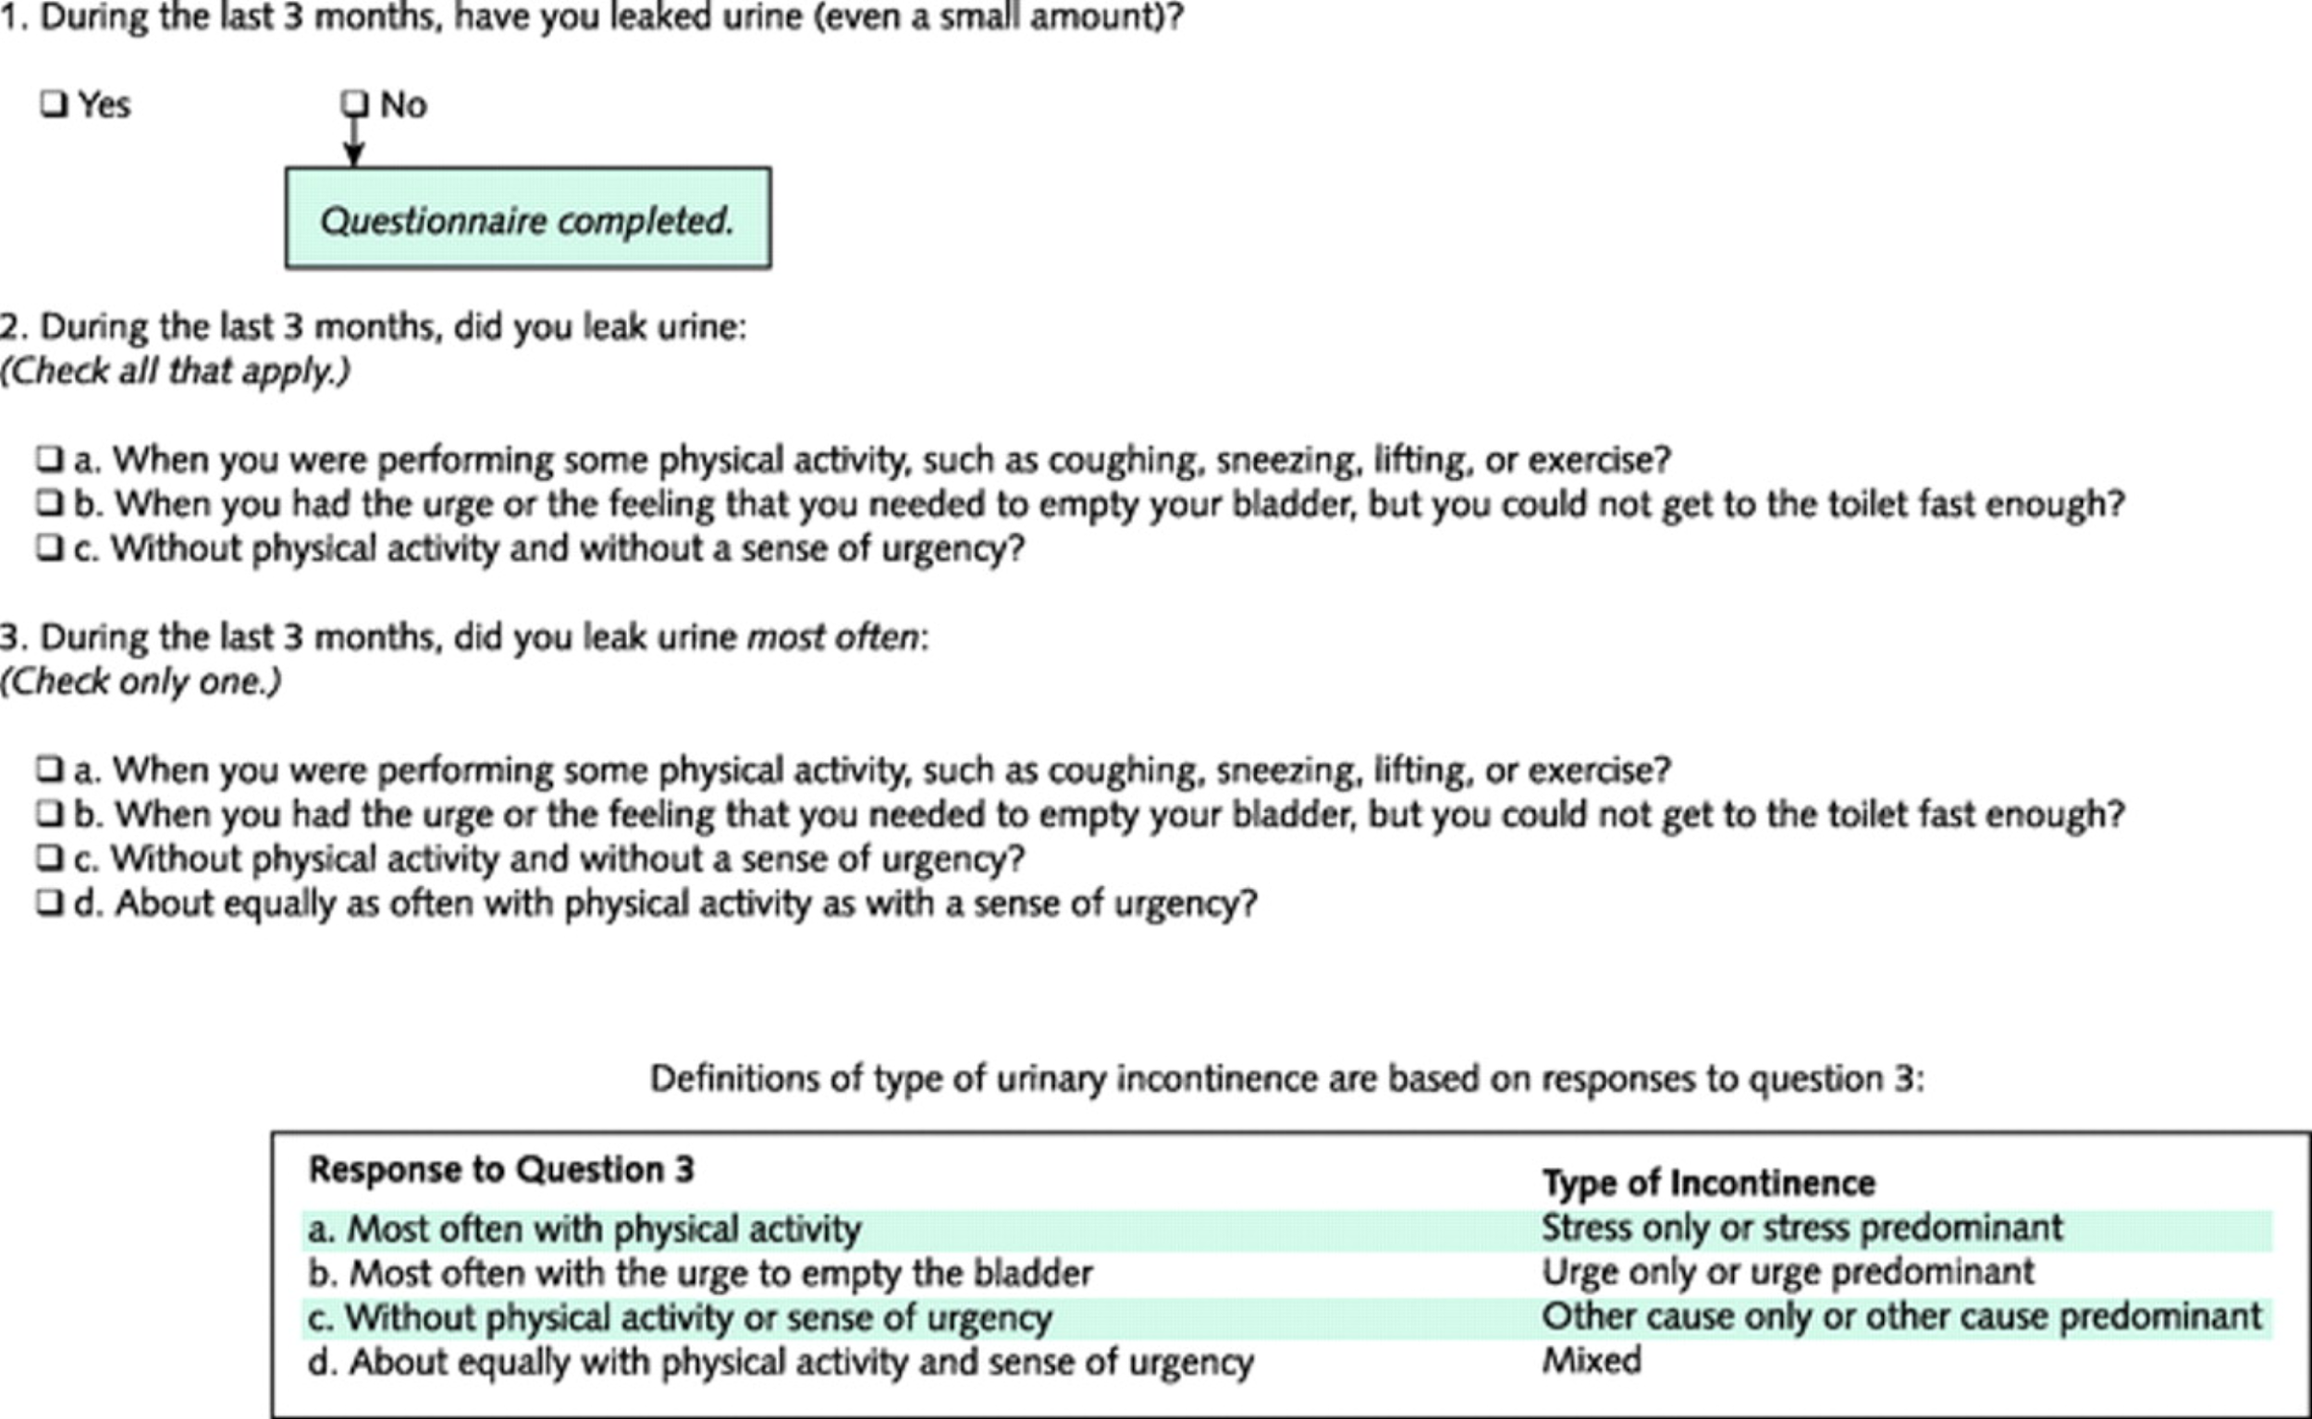
3IQ: Stress vs. Urge Questionnaire
Brown et al Ann Intern Med 2006
Notes:
Quick and Easy, noninvasive questionnaire, Sensitivity and Specificty for UUI: 75% and 77% and a positive likelihood ratio of 3.3. For SUI, the sensitivity was 86% the specificity 60%, and the positive likelihood ratio was 2.1.

Slide 21
Evaluation - Physical Exam
Abdominal exam
Neurologic exam
  Sensation, reflexes
    Bulbocavernosis/clitoral-sacral reflex (S2, S3, S4)
Pelvic Exam
  Inflammation, infection, vaginal atrophy or discharge
  Urethral diverticulum
  Assess levator ani function and strength (Kegel)
  Pelvic organ prolapse
  Urethral hypermobility

Slide 22
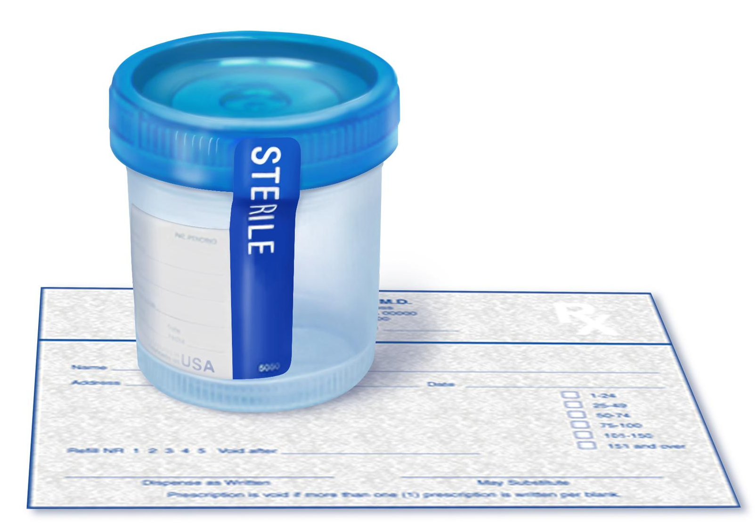
Focused UI Elements
Urine dipstick
UA with urine culture
Post void residual
  Straight catheterization vs. bladder scanner
  Cough stress test

Slide 23
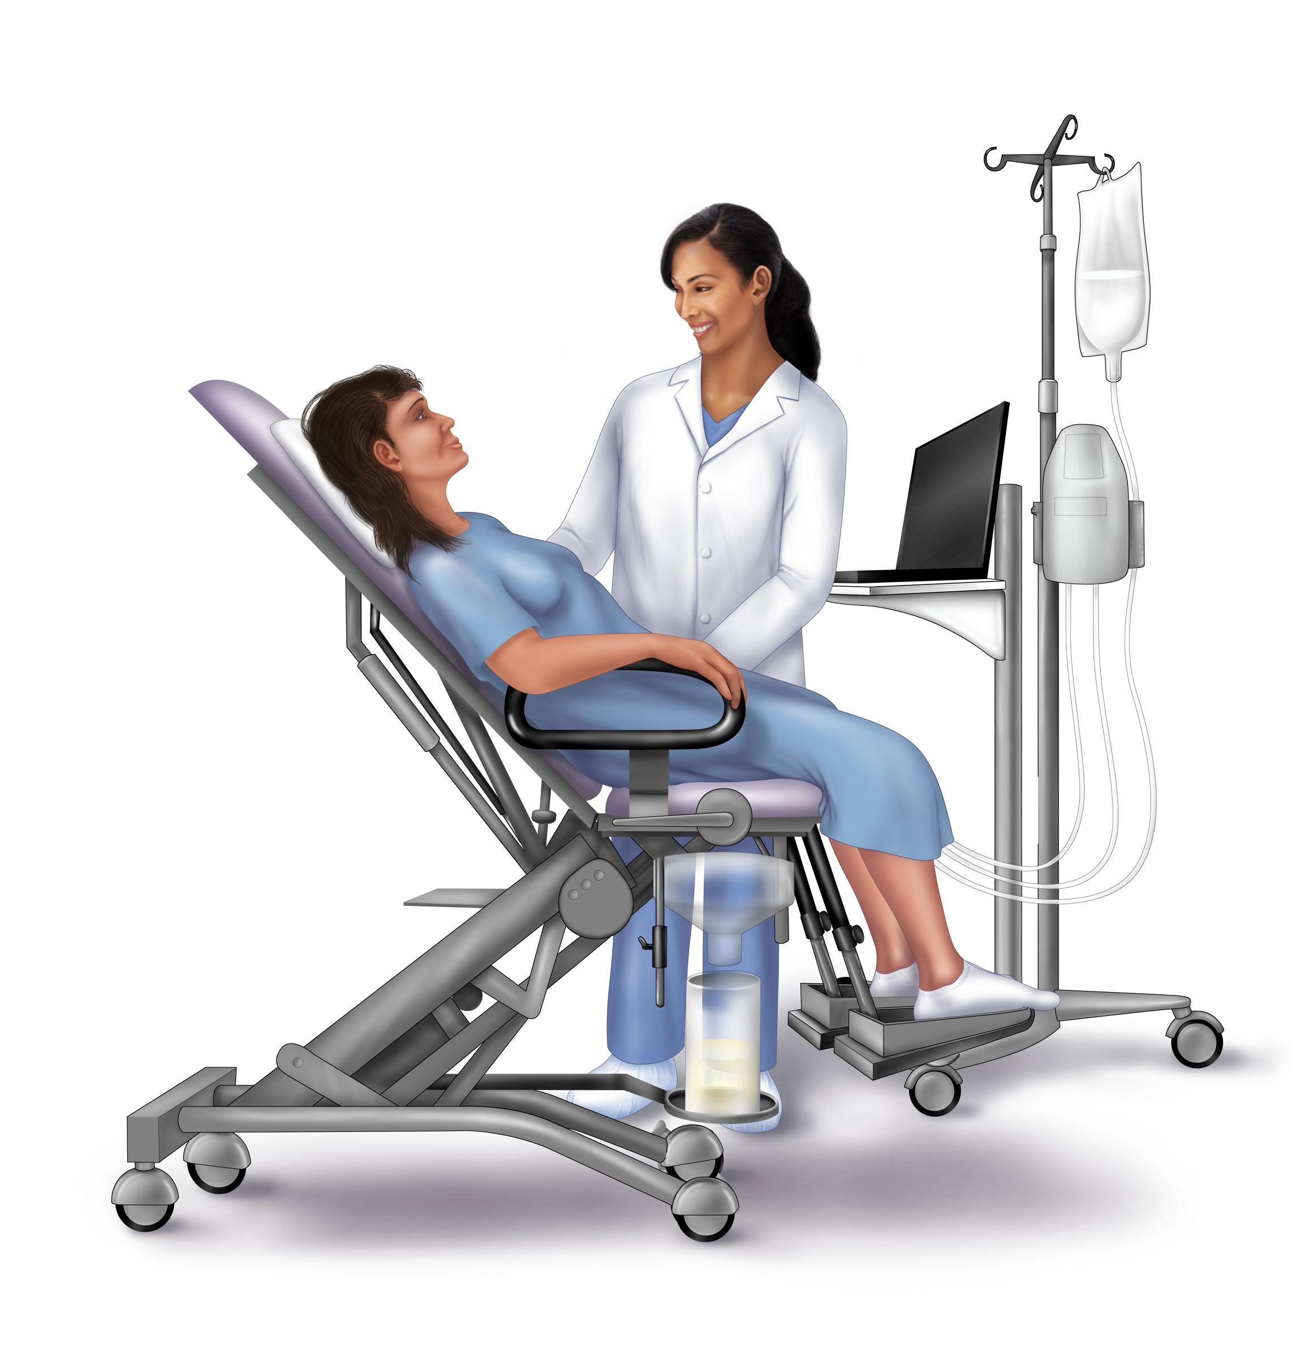
Urodynamic Testing:
To Do or Not To Do?
When to order:
  Voiding dysfunction
  Neurologic concerns
  Unclear history, insensible, “wet all the time,” mixed symptoms
  Prior anti-incontinence surgery
  Recurrent SUI
ValUE Trial
  Treatment success at 12 months in-office evaluation group was non-inferior to UDS group
  These results argue against routine preoperative urodynamic testing in patients with uncomplicated stress urinary incontinence
Notes:
When To order as recommended by International Consultation on Incontinence
VALUE: Nager et al N Engl J Med 2012; 366:1987-1997 11 center (n=630) randomized non-inferiority trial, office evaluation vs. UDS, 3 mo of SUI or SUI predominant UI (on MESA questionnaire), PVR <150cc, UA/Ucx neg, assessment of urethral hypermobility, + CST, desire surgery for SUI(excludes prior SUI surgery, pelvic surgery in last 3 months, POPQ >+1, irradiation), blinded postop eval 3mo, 12mo, Primary outcome UDI symptoms/qol and PGII satisfaction, CST 300cc. Treatment success at 12 months in office evaluation was non inferior to UDS group. Concludes, “with respect to success of treatment at 1 year, this study showed that a basic office assessment for women with uncomplicated stress-predominant urinary incontinence who have stress incontinence on office evaluation is noninferior to a preoperative evaluation that also includes urodynamic testing.”

Slide 24
Treatment Options
Pelvic floor muscle exercises (with or without PT)
Non-surgical (support devices)
Ambulatory procedure (urethral bulking)
Surgical (mesh vs. no mesh)

Slide 25
Conservative Management of SUI
Kegels
PFMT with a pelvic floor physical therapist
PFMT and SUI
  Pure SUI:
    PFMT groups were 8 times more likely than the controls to report that they were cured
    17 times more likely to report cure or improvement
  Any type UI:
    same trend, smaller effect size
Dumoulin et al Cochrane Database Syst Rev. 2014
Notes:
Cochrane 2014 PFMT and SUI: Primary Aim: determine effects of PFMT for UI vs. no treatment/placebo/sham
Inclusion criteria: RCTs with SUI, UUI, MUI where 1 arm PFMT, another inactive arm.
21 trials n=1281 (665 pfmt, 616 controls) , This is truly for SUI as no studies with mixed or uui alone
Conclusions: All were more satisfied with the active treatment
Control groups were more likely to seek further treatment.
Two trials (one small and one moderate) some evidence of effects lasting 12 mo.
Pure SUI: PFMT groups were 8 times more likely than the controls to report that they were cured (46/82 (56.1%) versus 5/83 (6.0%), RR 8.38, 95% CI 3.68 to 19.07) 17 times more likely to report cure or improvement (32/58 (55%) versus 2/63 (3.2%), RR 17.33, 95% CI 4.31 to 69.64)

Slide 26
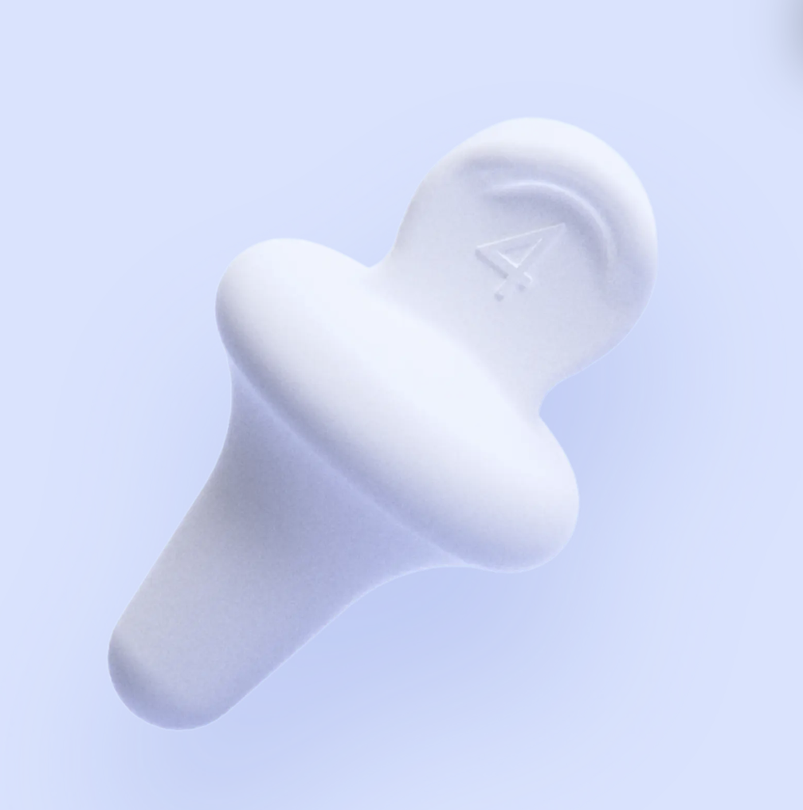
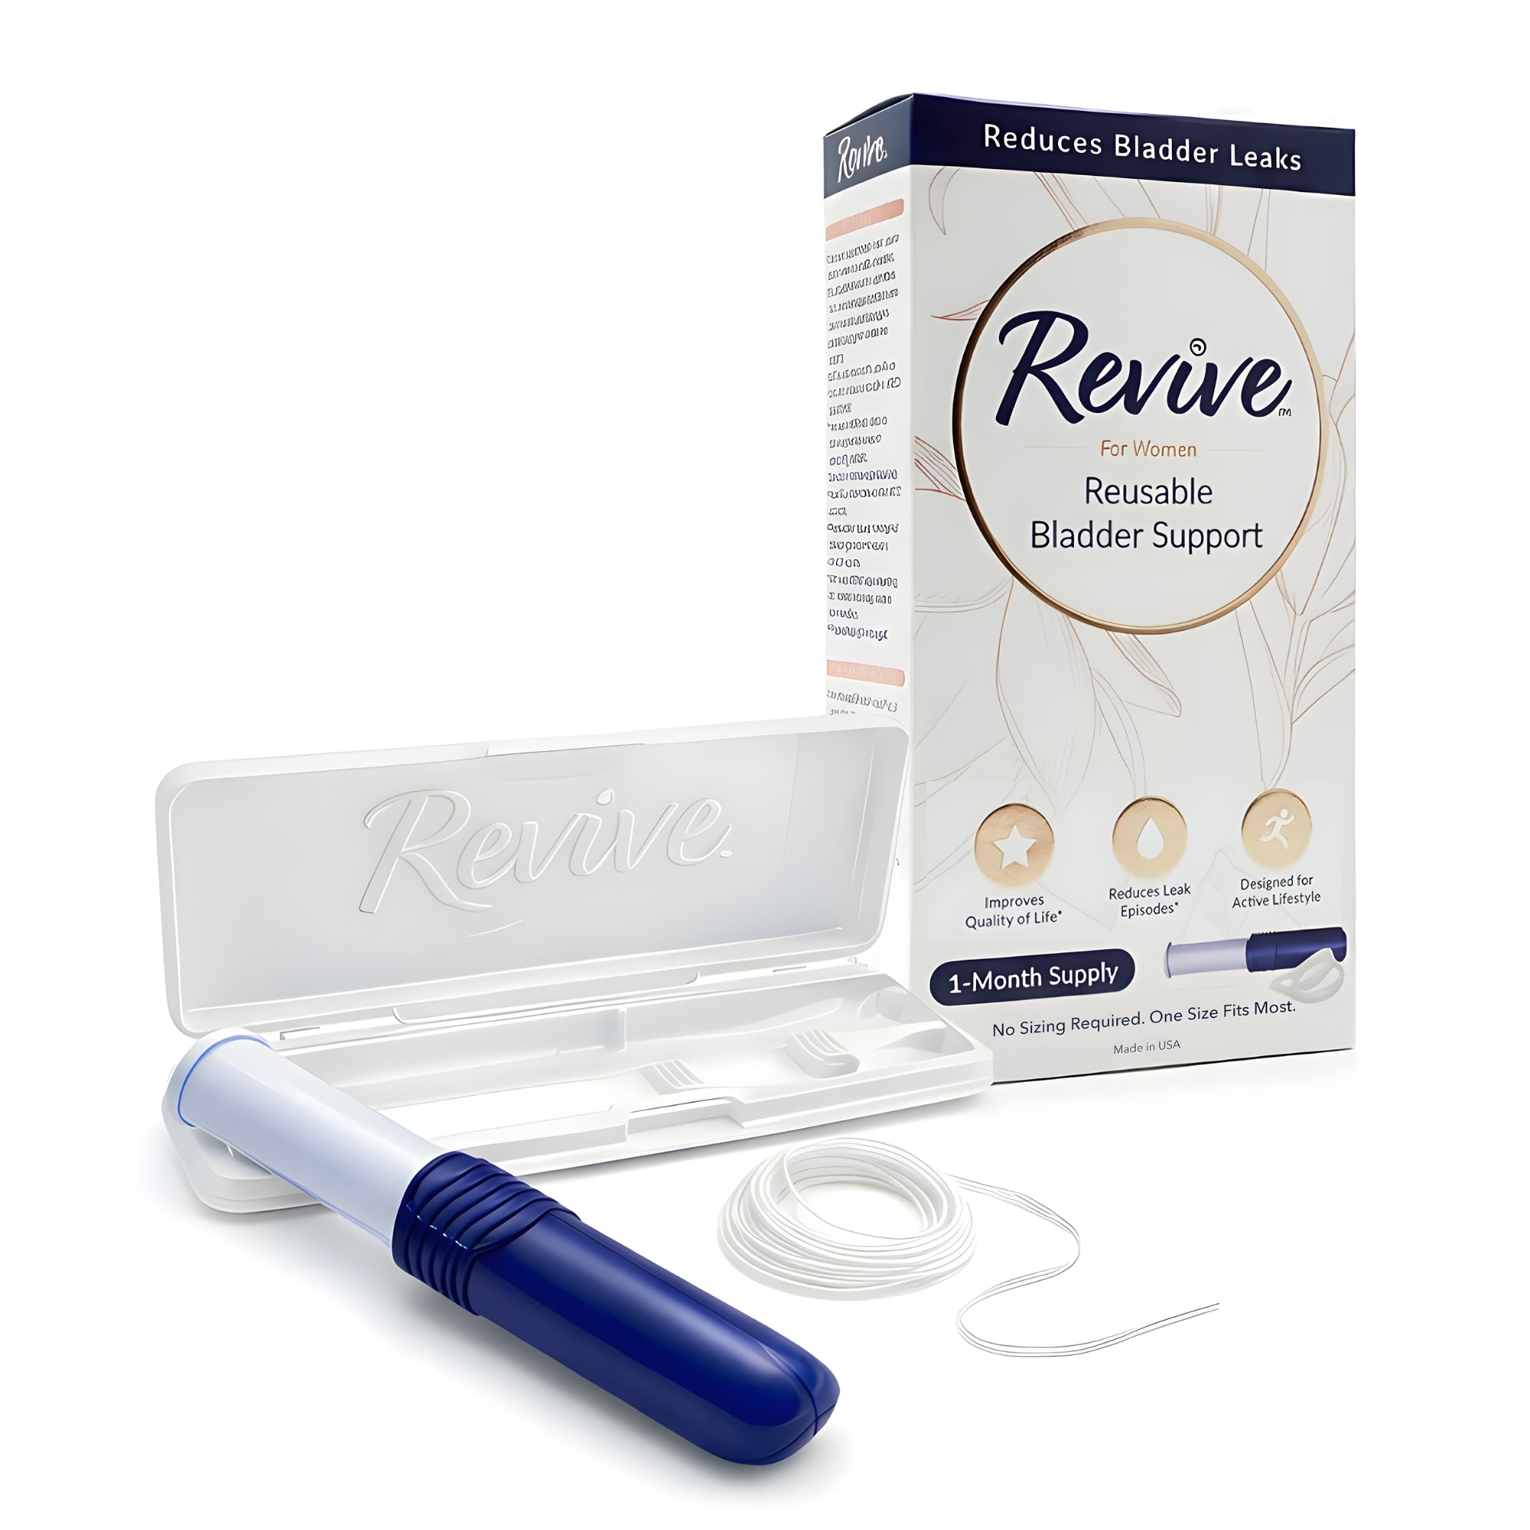
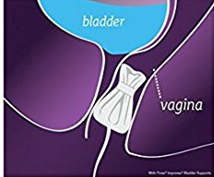
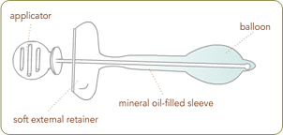
Non-Surgical Management
Notes:
Pessaries, Inserts (urethral like *femsoft, femguard, capsure, miniguard etc), Tampons (or specific OTC Impressa)

Slide 27
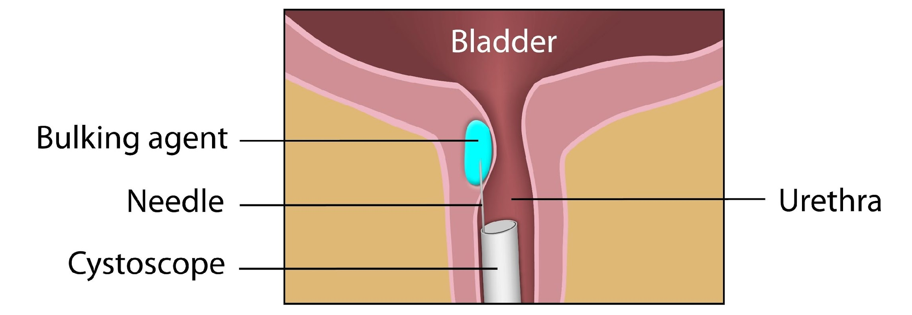
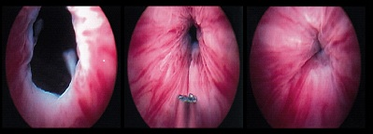
Urethral Bulking
    Coapt the “lead-pipe” urethra
    96% improve at some point, 83% dry at some point, 52% still dry at 1 yr, 38% still dry at 2 yr
    Coaptite®, Bulkamid®, Durasphere®, Macroplastique®
Notes:
Intrinsic Sphincter Deficiency without hypermobility
Coaptite ®
calcium hydroxyapatite particles – a constituent of human bone and teeth; is radio-opaque (identifiable w/ plain film or u/s)
Bulkamid ®
water based hydrogel: polyacrylamide
Durasphere®
pyrolytic carbon-coated beads
Macroplastique®:
hydrogel-suspended crosslinked polydimethyl-siloxane elastomer; relatively large silicone rubber particles

Slide 28
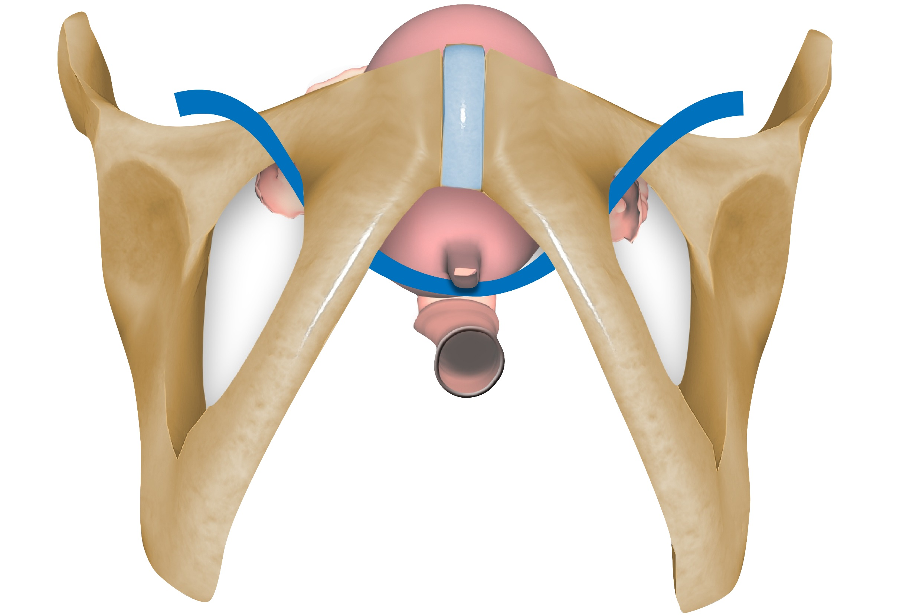
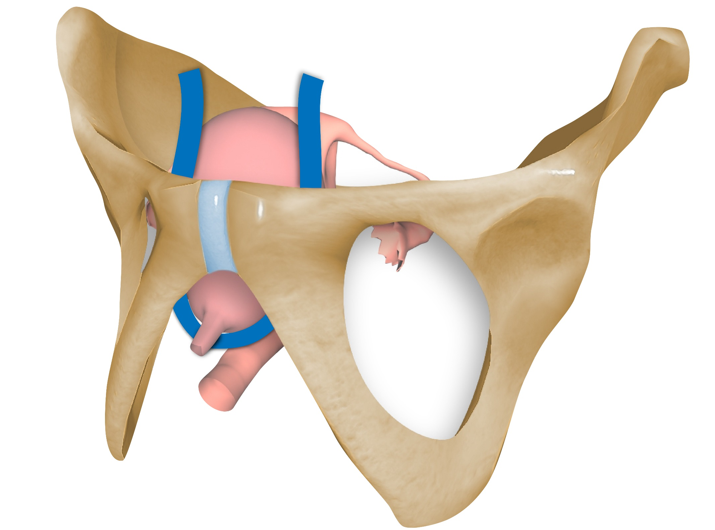
Surgical Treatment:
Mesh Mid-urethral Slings
Transobturator
Retropubic
Notes:
2015 Cochrane on slings
Transobturator vs. Retropubic
55 trials n=8652
No short term difference in subjective or objective cure (long term data limited to 6 trials, small n but still no difference)
No difference in mesh erosion
Equal improvement in QOL and sexual function
E-TOMUS (Kenton et al J. Urol Jan. 2015: 193; (203-210) n-404 5year sp to/rp . Slightly higher success rate at 5yr in RP (51v43% absolute rates decreased over time), but satisfaction higher in TO (85%/79% ), “women in TO group report more sustained improvement in symptoms and sexual function” no difference in erosion

Slide 29
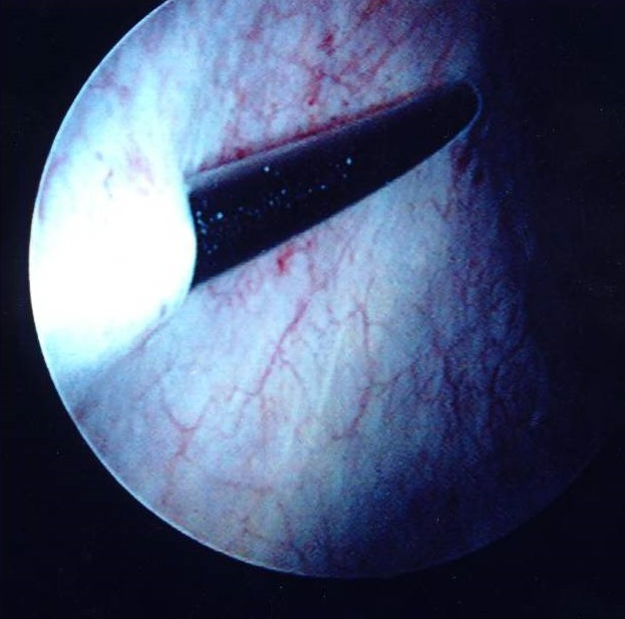
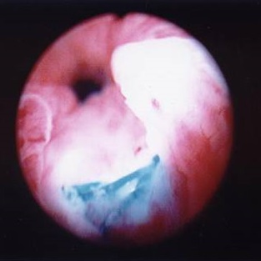
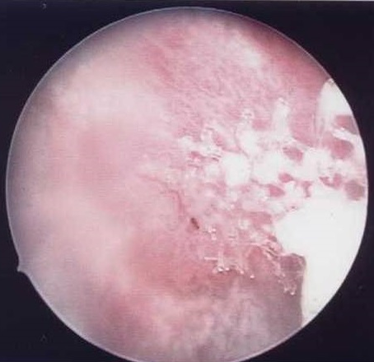
Complications
Notes:
2015 Cochrane for slings cont’d
RP vs TO
30 fold higher rate of bladder perforation with RP vs TO
Higher voiding dysfunction with RP vs TO
Higher groin pain in TO (mostly resolved at 8 weeks)- followup study showed prevalence very low and higher in TO at 6 weeks but equal at 6 months between groups
RP bladder perf 3%, voiding dysfunciton 2%, mesh erosion 1%, hematoma 1%
TO bladder perf 0.4%, retention .5%, hematoma .5% erosion .5% groin pain 1.6%
Both reoperation 1-2%

Slide 30
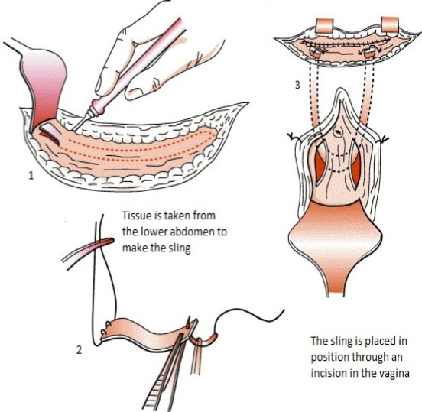
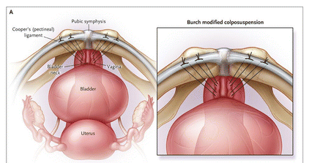
Surgical Treatment: Non-Mesh
Fascial Sling: Autologous or Cadaveric
Burch Procedure
https://www.urology.co.nz/info/pubovaginal-sling
Albo et al NEJM 2007
Notes:
NEJM: Burch vs Fascial sling n=655 24 months success rate higher in sling than burch v fascial sling: SUI success 66% vs 49% (overall success 47% v 38%)
Sling: higher UTI, voiding dysfunction and postop urge

Slide 31
Overactive Bladder

Slide 32
OAB - Definition
Overactive Bladder Syndrome
  Urgency
  Frequency (6-8 daytime voids)
  Nocturia (>1 time interrupted sleep/night)
  With or without incontinence
  Absence of UTI or obvious pathology
Detrusor Overactivity
  Involuntary contractions on urodynamics during filling
Notes:
Definitions by International Continence Society
DO not part of the definition for OAB (~50% have DO)
Urgency is defined by the International Continence Society (ICS) as the “complaint of a sudden, compelling desire to pass urine which is difficult to defer.”
Urinary frequency can be reliably measured with a voiding diary. Traditionally, up to 7 micturition episodes during waking hours has been considered normal, but this number is highly variable based upon hours of sleep, fluid intake, comorbid medical conditions, and other factors.
Nocturia is the complaint of interruption of sleep 1 or more times because of the need to void.
Urgency urinary incontinence is defined as the involuntary leakage of urine, associated with a sudden compelling desire to void.

Slide 33
Risk Factors
Insulin-dependent diabetes
Depression
Age >75 years old
Arthritis
Oral hormone replacement therapy
Increased BMI
Estrogen deficiency in older women
Other physiologic changes associated with aging, such as decreased bladder capacity and changes in muscle tone
Prior pelvic surgery or radiation

Slide 34
Causes
“DIAPPERS”
Other Causes:
Delirium
Infection – urinary
Atrophic vaginitis
Pharmaceuticals
Psychologic disorders
  Depression, excessive water intake (patients on lithium)
Excessive urine output
  Heart failure, hyperglycemia
Restricted mobility
Stool impaction
Gastrointestinal (GI) or colonic pathology
Gynecologic pathology
Urinary tract obstruction
Urinary stone disease
Uterine or anterior vaginal wall prolapse
Vesicovaginal fistula
Bladder cancer
Notes:
Transient or reversible incontinence – pneunomic

Slide 35
Evaluation - History
History like SUI with additional focus on…
  Neurologic History:
    Brain, spinal cord, peripheral neuropathy
  Lifestyle: fluid intake, caffeine, alcohol, constipation
  Associated Diseases: CHF, DM, sleep disorders
  Medications: diuretics, antipsychotics, cholinesterase inhibitors

Slide 36
Evaluation – Physical Exam
Same as SUI with attention to
  Neurologic Exam (Lumbosacral nerve roots)
    DTRs
    Lower extremity strength
    Bulbocavernosis/clitoral-sacral reflex (S2, S3, S4)
  Vaginal atrophy
  Rectal Exam (impaction)
  PVR

Slide 37
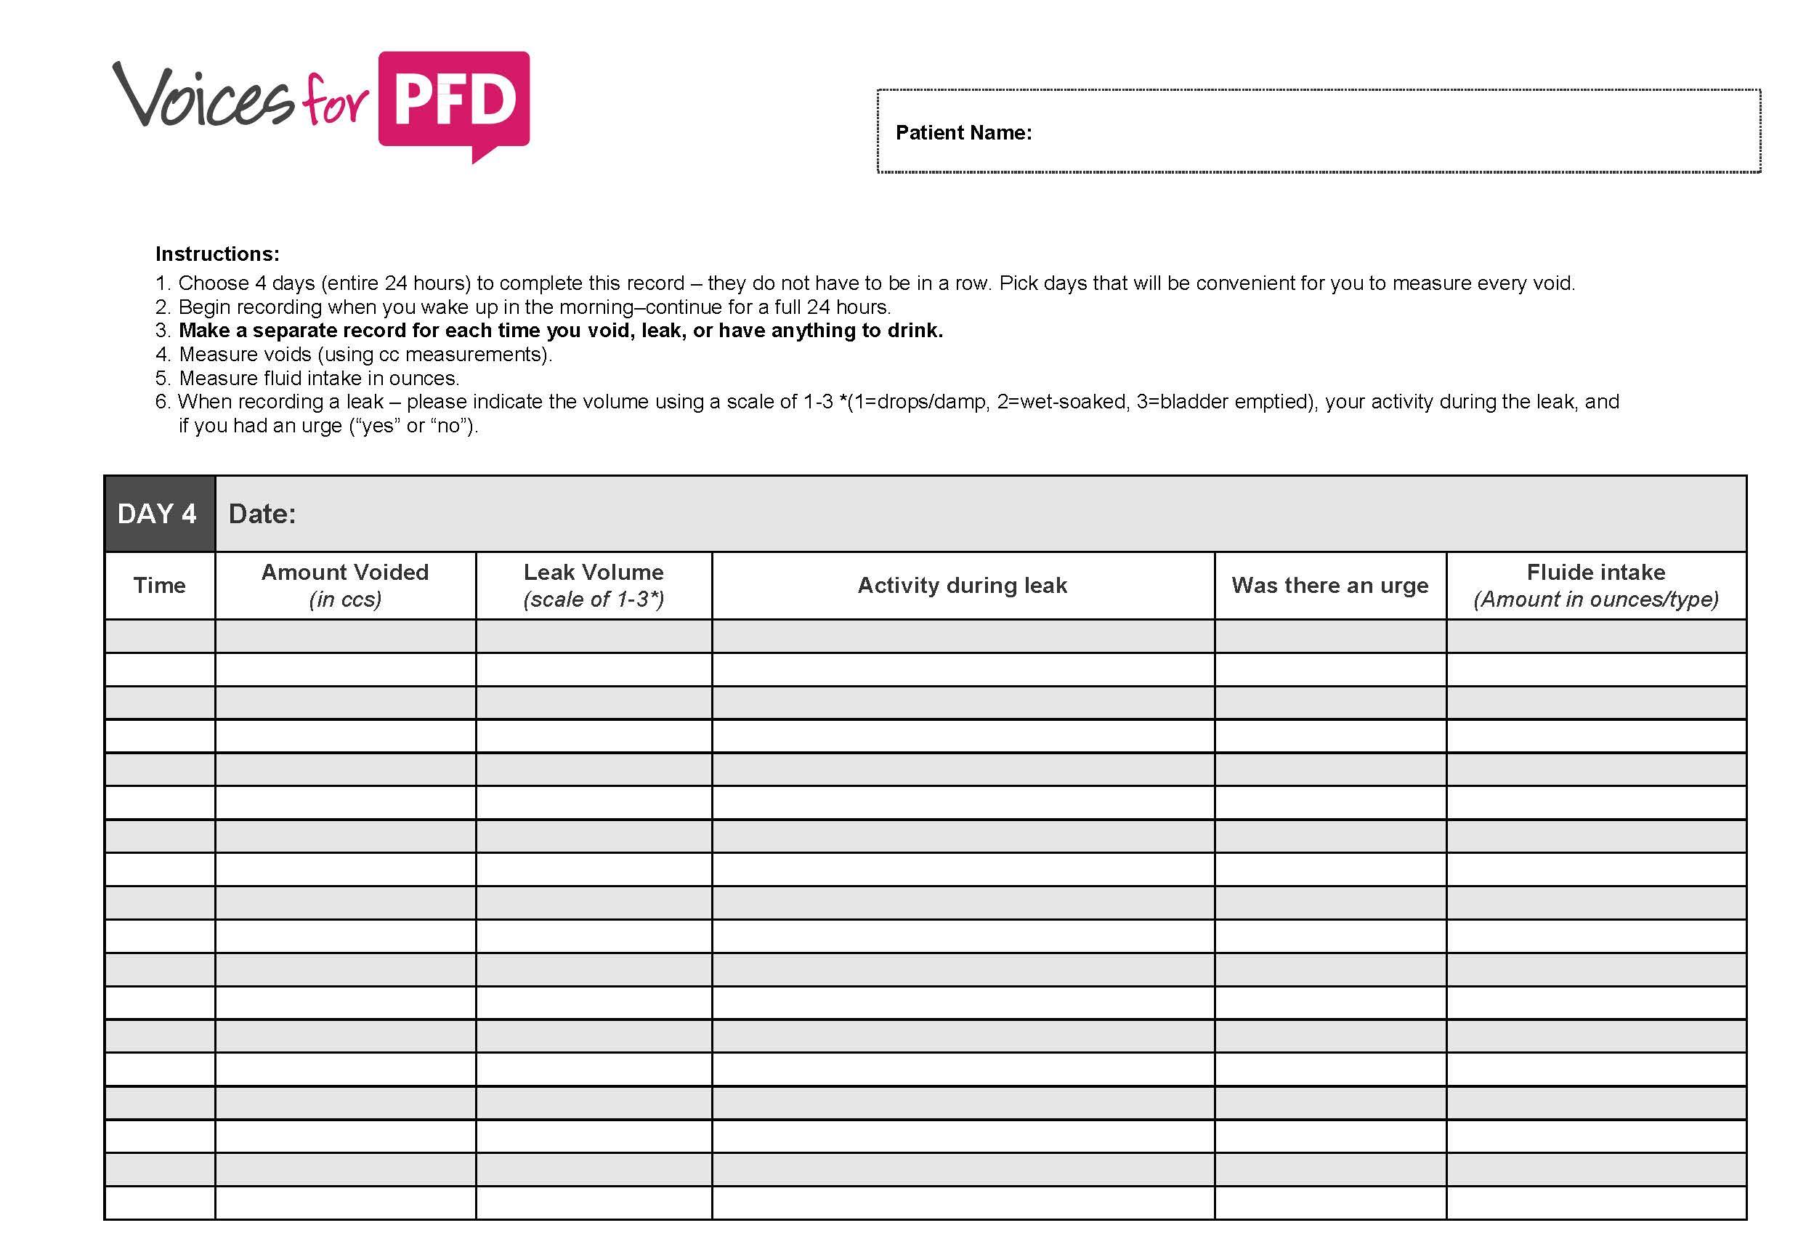
Evaluation - Voiding Diary
Notes:
Note 3 days has been shown to be as effective as 4-7. Choose 3 representative days.
Rule out Polyuria, Nocturnal Polyuria-🡪 this would lead to an endocrine/medicine workup instead

Slide 38
Indications for Cystoscopy
  Risks for malignancy (smoker, hematuria, positive cytology, h/o bladder cancer, occupational exposure)
  Elevated PVR
  Recurrent UTI
  Mixed symptoms with pain
  Persistent/denovo OAB after incontinence surgery, mesh, pelvic surgery, Botox injections, removal of indwelling foley
  Refractory to medication (considering 3rd line therapy)
  Abnormal LUT imaging

Slide 39
Indications for Urodynamic Testing
Voiding dysfunction
Neurologic concerns
Prior incontinence surgery
Refractory to medications
  (considering advanced therapies)
  Insensible incontinence, “wet all the time”, mixed symptoms
Notes:
Pressure-flow studies to evaluate for obstruction (incomplete emptying, prior procedures etc. )

Slide 40
Treatment Options
Behavioral
Medical
Surgical

Slide 41
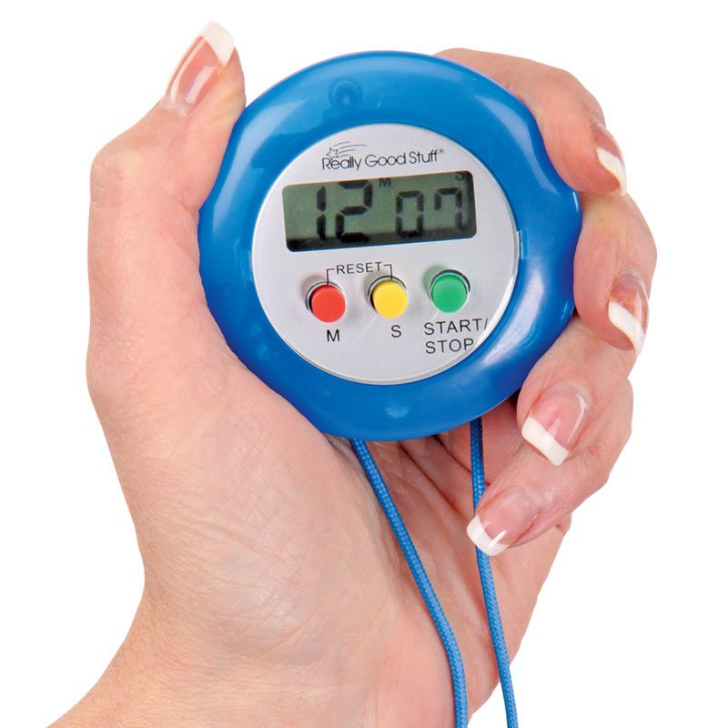
Conservative Treatment for OAB
Weight loss, avoiding irritants/dietary triggers, optimizing bowel regimen
Pelvic floor physical therapy
Fluid titration
Timed voiding
Notes:
-Timed voiding: single most effective intervention in nursing home population (if resources allow compliance)
-Anticholinergics in addition to behavioral therapy have additional benefit
-Burgio et al. Ann Intern Med. 2008: Behavior Enhances Drug Reduction of Incontinence BE-DRI (2 stage multicenter RCT by the UITN) study combining antimuscarinics (10 weeks detrol XR) +/- supervised behavioral training for UUI and combined therapy achieved >70% reduction in incontinence at 10 weeks but no difference in ability to discontinue meds

Slide 42
Medical Management
Antimuscarinics
  Contraindications: closed-angle glaucoma, gastroparesis, urinary retention
  **Cognitive effects**
  ?Trospium and darifenacin for cognitive safety
  Drying side effects (constipation, dry eye/mouth)
β-3 adrenergic receptor agonists: mirabegron (Myrbetriq) and vibegron (Gemtesa)
  Contraindication for mirabegron: uncontrolled hypertension
Vaginal estrogen for atrophic tissue (peri- and post-menopausal)
Notes:
Antimuscarinics Overall decrease in ~ 1 UUI episode/day
Oxytrol patch is available over the counter at 12$ for 2 patches (weekly cost)
Cognitive effects- are cumulative and can be irreversible (AUGS position statement) – be cautious in older patients
Santcura (Trospium) and Enablex (Darifenacin): “don’t cross the blood brain barrier”
Mirabegron: Causes relaxation of the detrusor smooth muscle of the urinary bladder, thus increasing bladder capacity

Slide 43
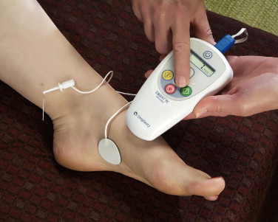
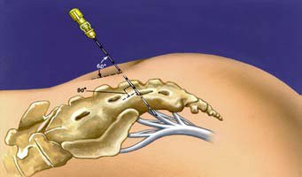
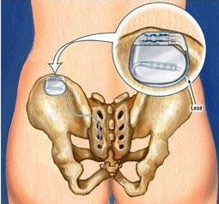
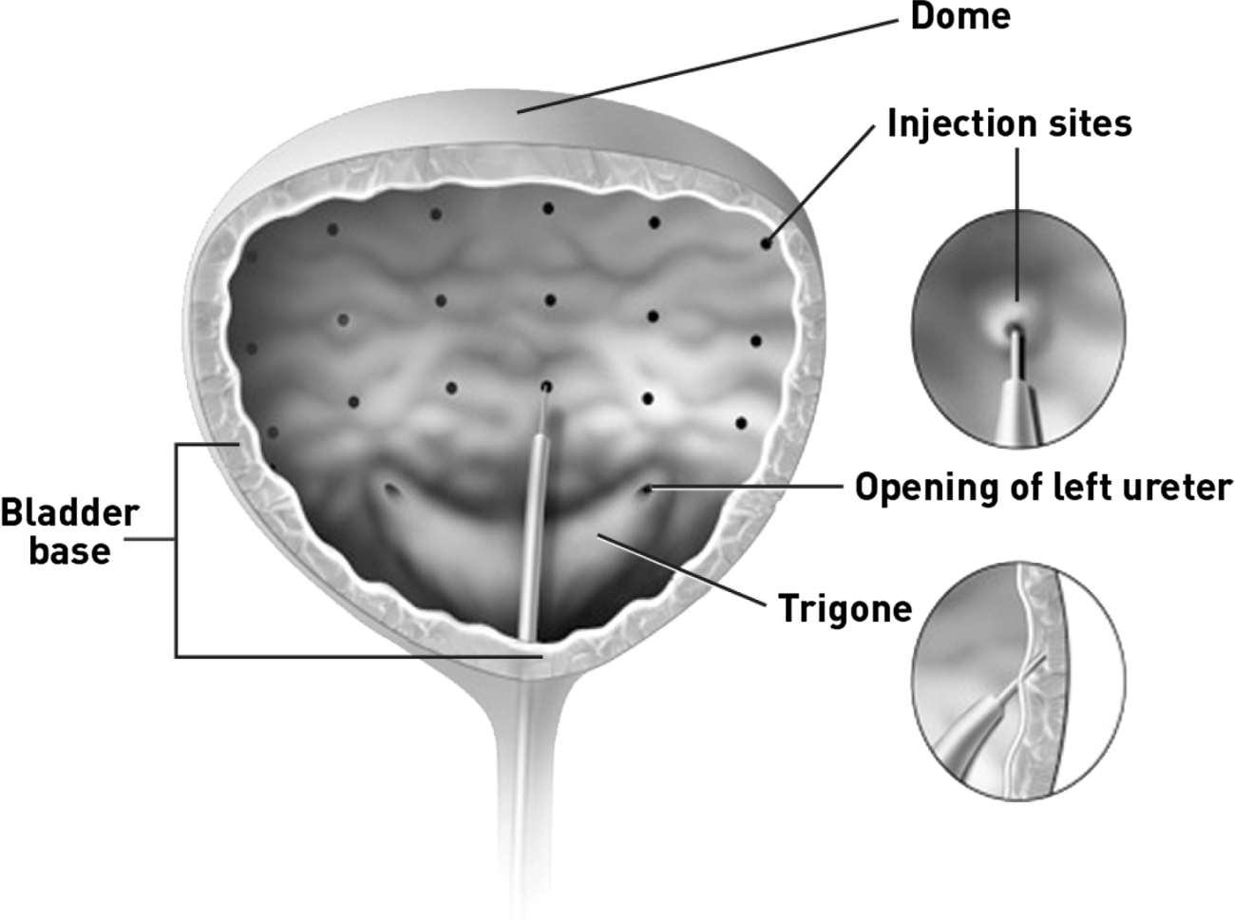
Surgical Therapies for OAB
Percutaneous Tibial Nerve Stimulation (PTNS)
Interstim® or Axonics® - sacral neuromodulation
Botox® - intradetrusor injections
  FDA for neurogenic bladder and refractory OAB
Altaviva® - implantable tibial neurostimulation
Medtronic, Inc.
Medtronic, Inc.
Icord.org
Notes:
PTNS: Current guidelines: weekly 30 minute session for 12 weeks Unclear data regarding “re-treatment”
Unblinded, multicenter trial of 100 patients with OAB randomized to PTNS vs 4mg XR tolterodine extended daily, after 12 weeks of therapy, there was no difference between the groups in the primary outcome of urinary frequency. Authors state that “PTNS is safe and offers improvements of OAB symptoms, with objective effectiveness comparable to pharmacotherapy.” 71% of patients are responders
Finazzi-Agrò E, et al. J Urol. 2010;184:2001-2006.
ABC: Antimuscarinics vs. Botox: Comparable reductions in frequency of daily episodes of urgency urinary incontinence, Those receiving onabotulinumtoxinA: less dry mouth, more likely to be dry, but higher rates of transient urinary retention and UTI Visco AG, et al. N Engl J Med. 2012;367:1803Y1813
INTERSTIM
FDA approved for refractory UUI, nonobstructive urinary retention, fecal Incontinence; some off label use for IC and high tone pelvic floor dysfunction (pain)
Botox vs. Interstim : ROSETTA trial Amundsen et al. JAMA 2016: women with refractory UUI multicenter RCT n = 364, botox (200 u) group had a greater reductino in 6 month mean number of UUI episudes than the SNM group (small difference 3.9 vs 3.3 statistically significant ? Clinically significant). Botox had greater improvement in symptom bother, higher satisfaction and treatment endorsement. NO differences in convenience, adverse effects and treatmenet preference. UTI (35% v 11%) and need for self-cath (none in interstime, 8% at 1 mo and 2% at 6 mo for botox) was higher in the Botox group

Slide 44
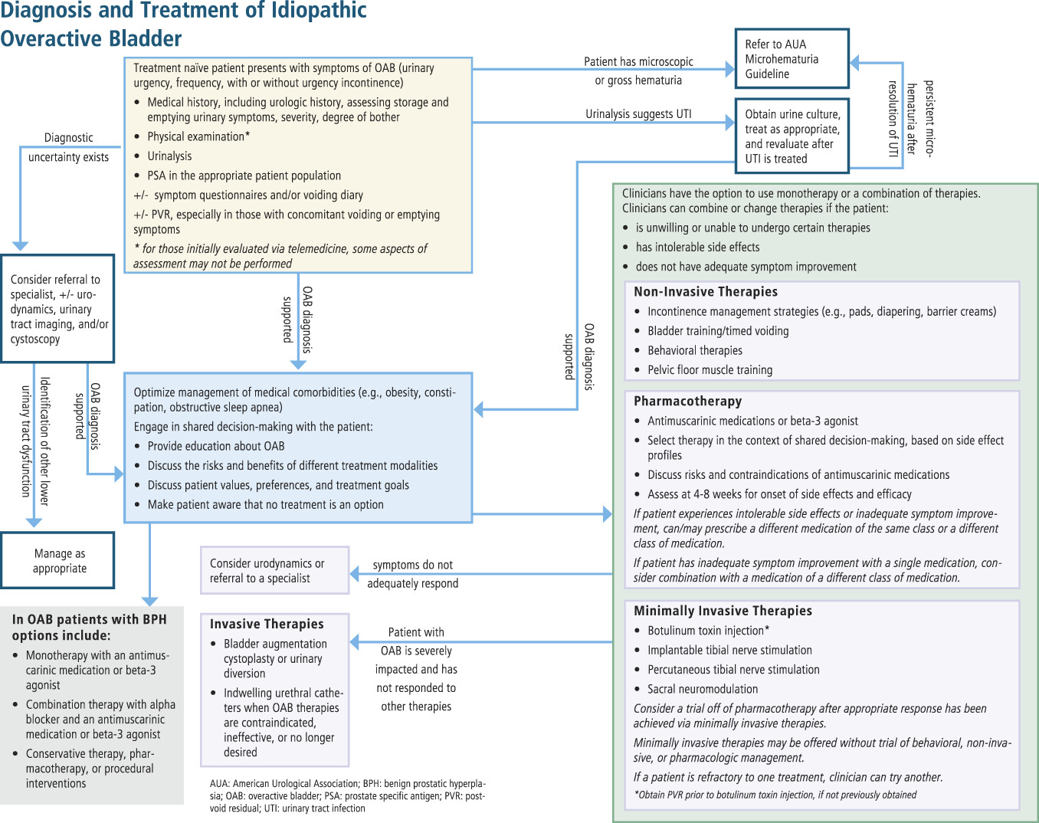
Diagnosis & Treatment Algorithm
AUA/SUFU guidelines on non-neurogenic overactive bladder in adults
Notes:
AUA/SUFU Guidelines/algorithm for non-neurogenic OAB

Slide 45
Pelvic Organ Prolapse (POP)

Slide 46
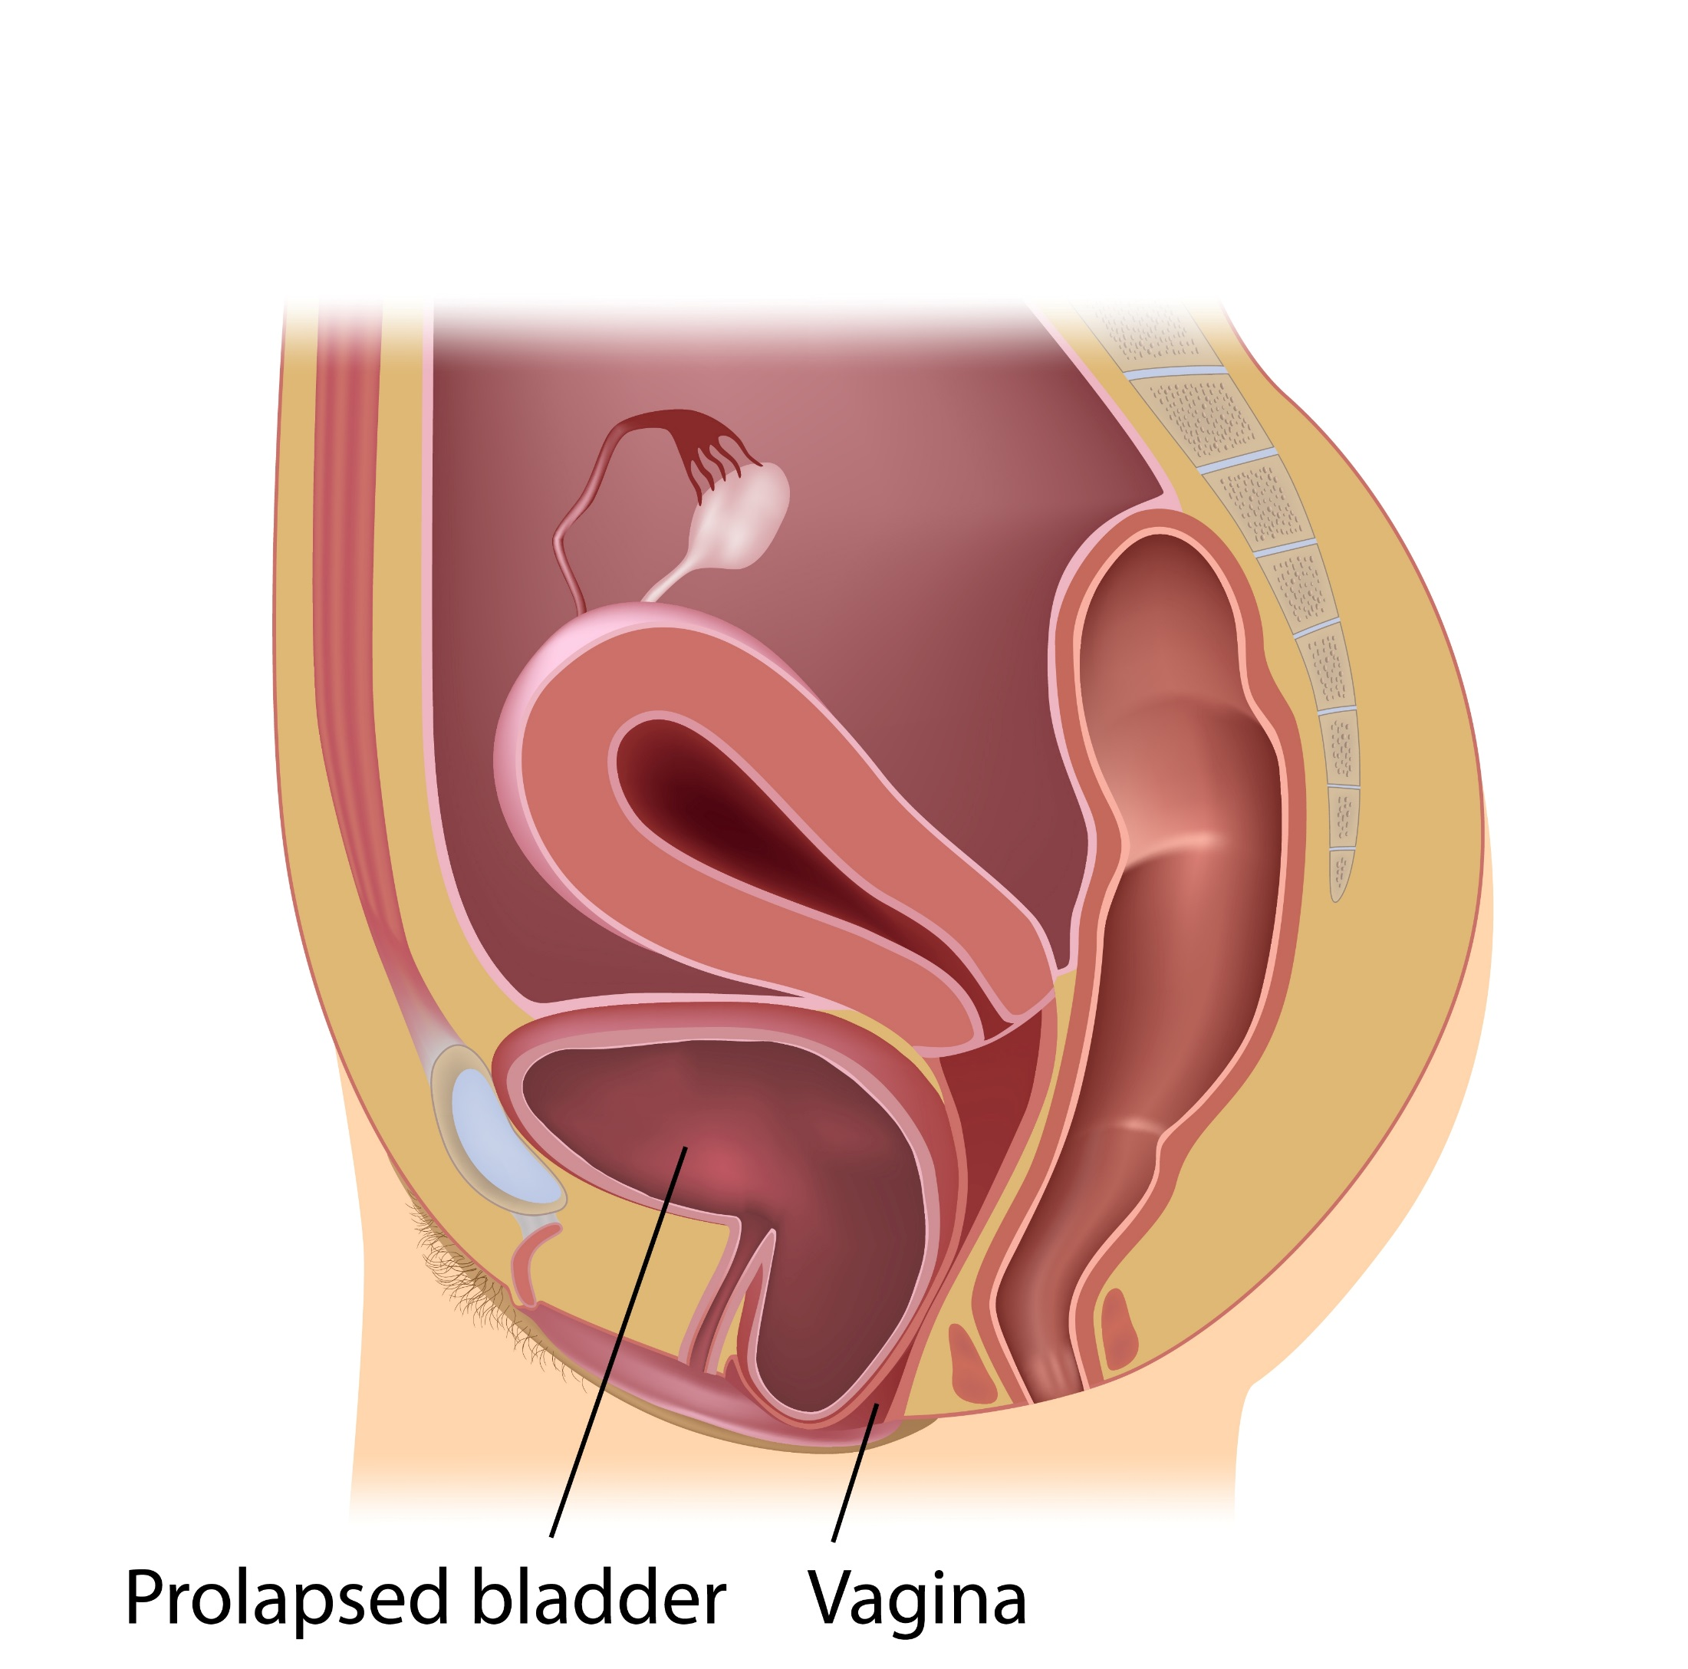
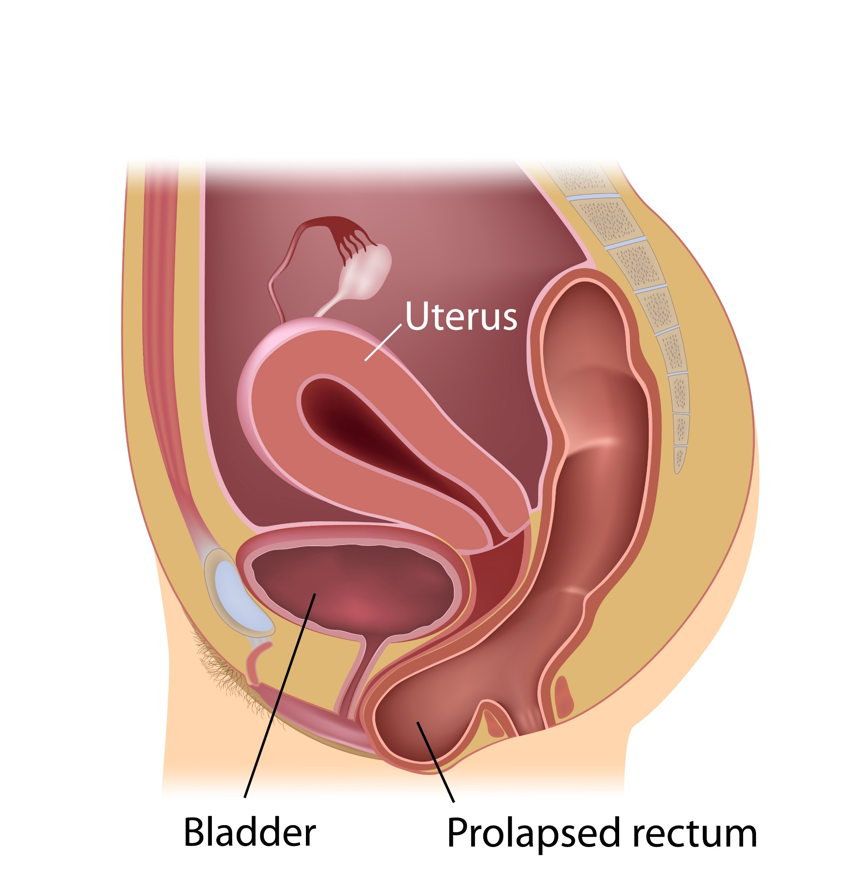
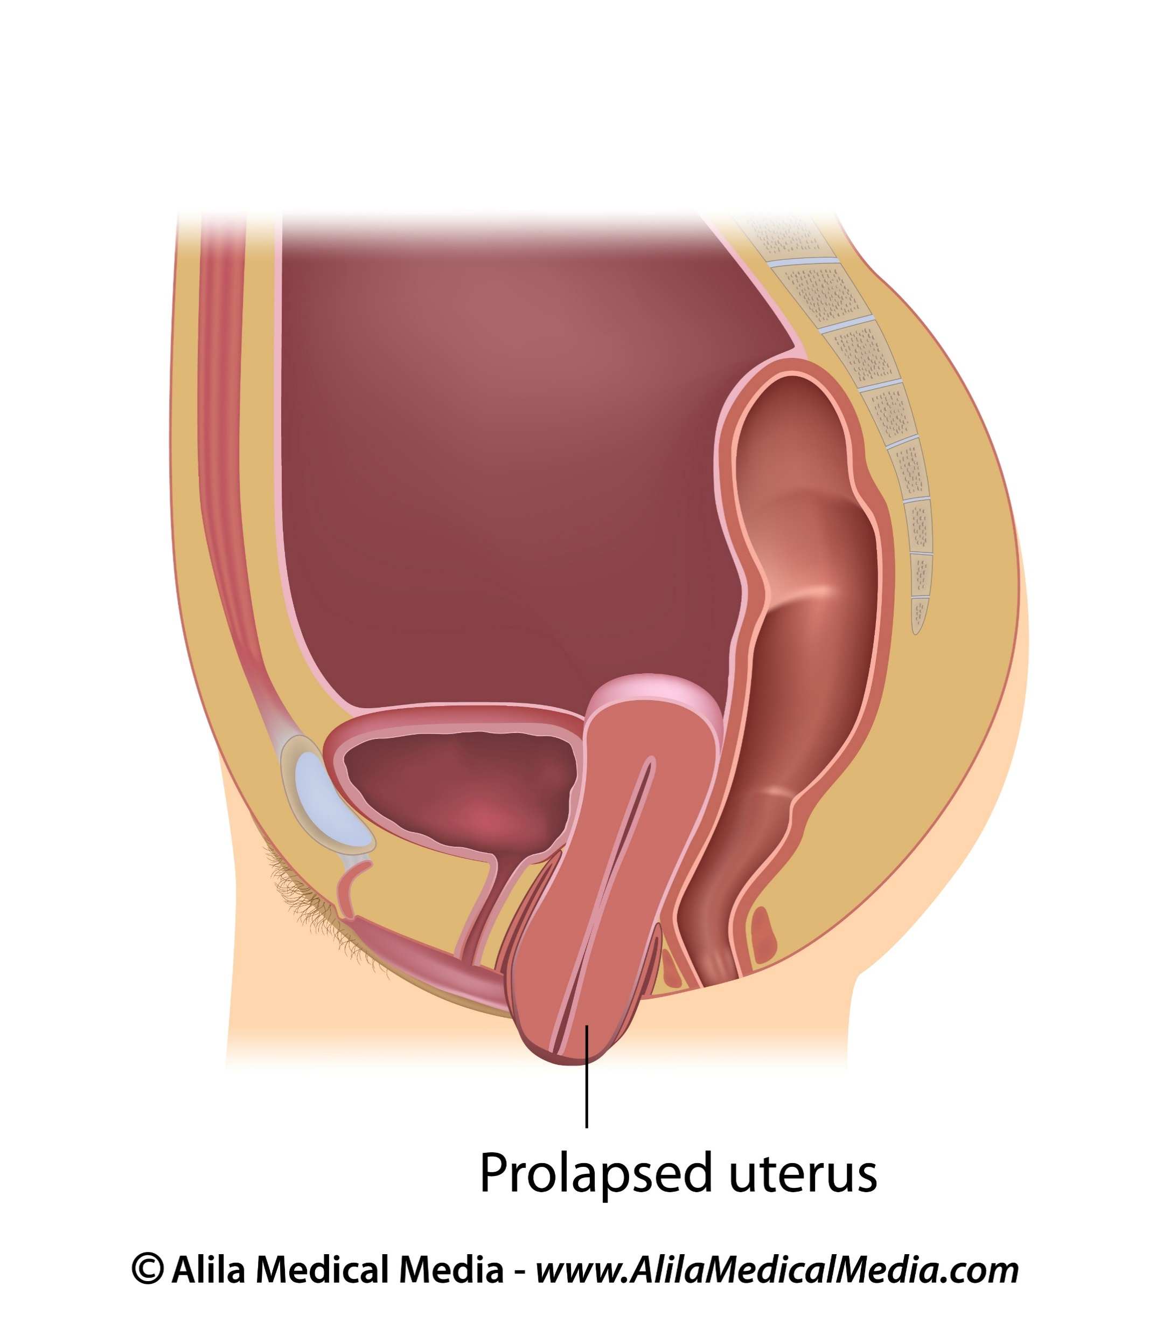
POP—Anatomy Basics
Cystocele
Rectocele
Uterine Prolapse

Slide 47
Risk Factors
Age
BMI
Parity
Large babies
Prolonged labor
Operative delivery
Genetics
Connective tissue disease (EDS)
Pelvic surgery
Menopause/hormonal status

Slide 48
Evaluation: History
Simplest screen: “Do you feel or see a bulge coming out of the vagina?”
History:
  Medical, surgical, obstetric, gynecologic, sexual, social (gauge how this affects their daily life)
Symptomatic? Bothersome?
  Pelvic pressure and bulge
  Urinary: difficulty emptying, positional voiding
  Defecatory: pushing, straining, splinting or manually evacuating
  Sexual Dysfunction: Active? Pain, embarrassment

Slide 49
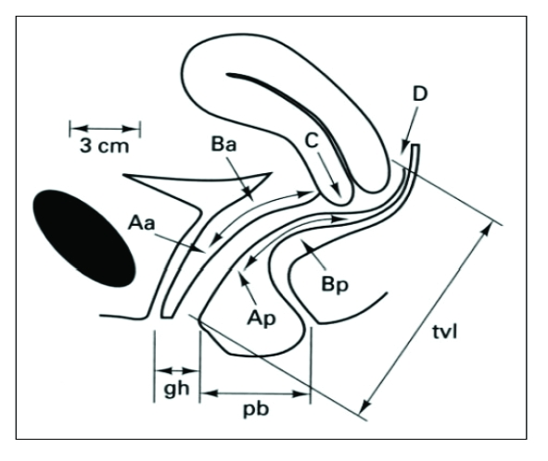
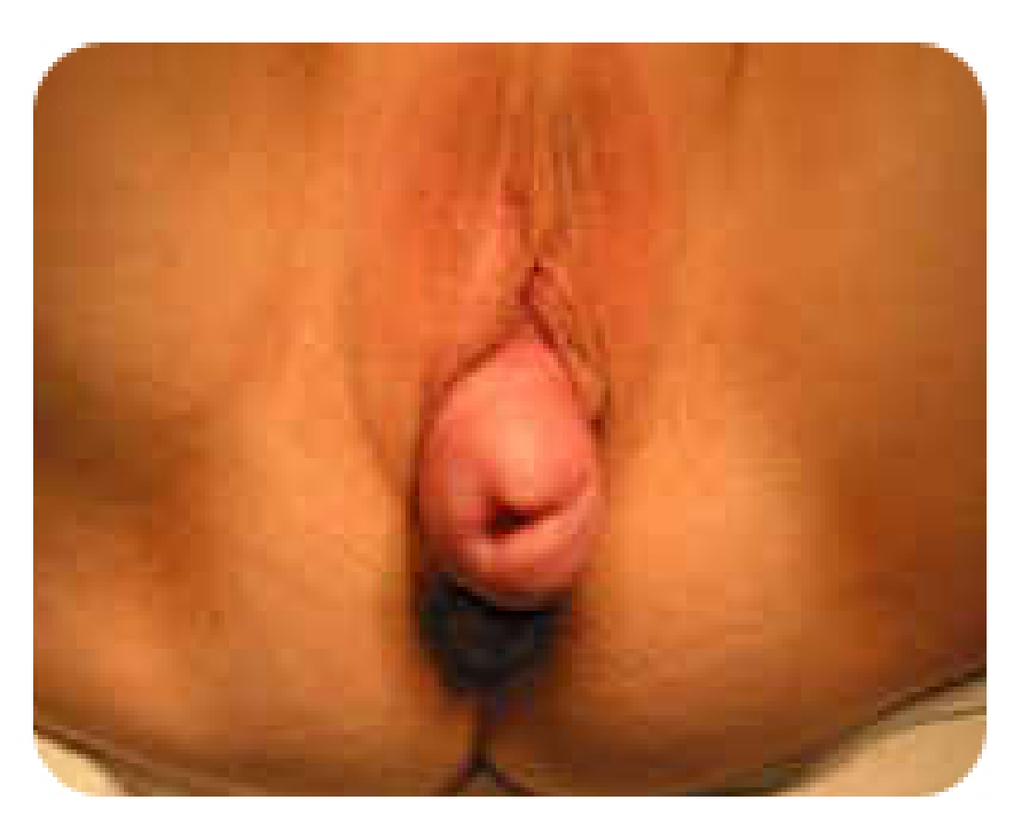
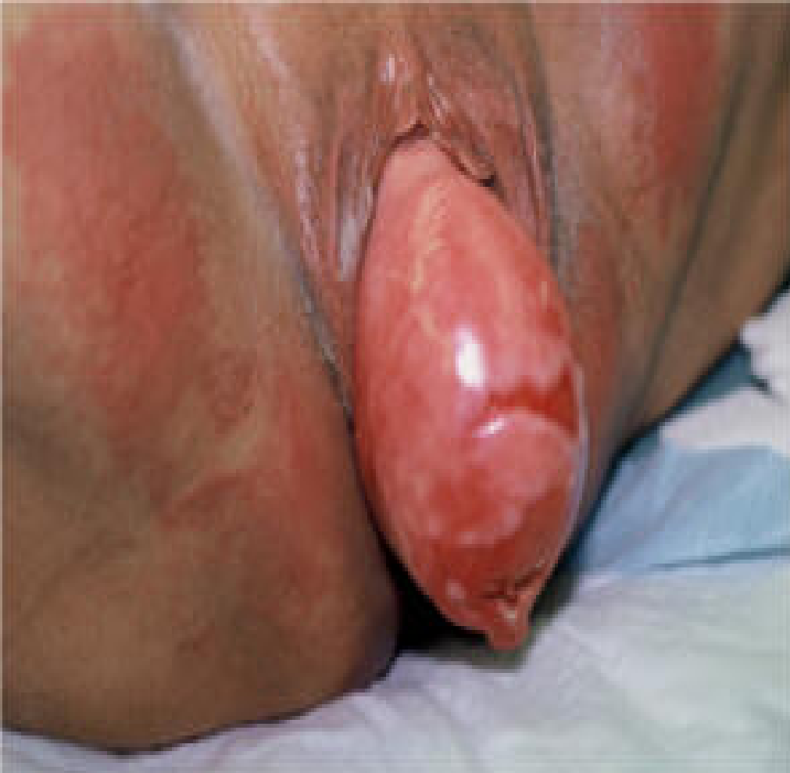
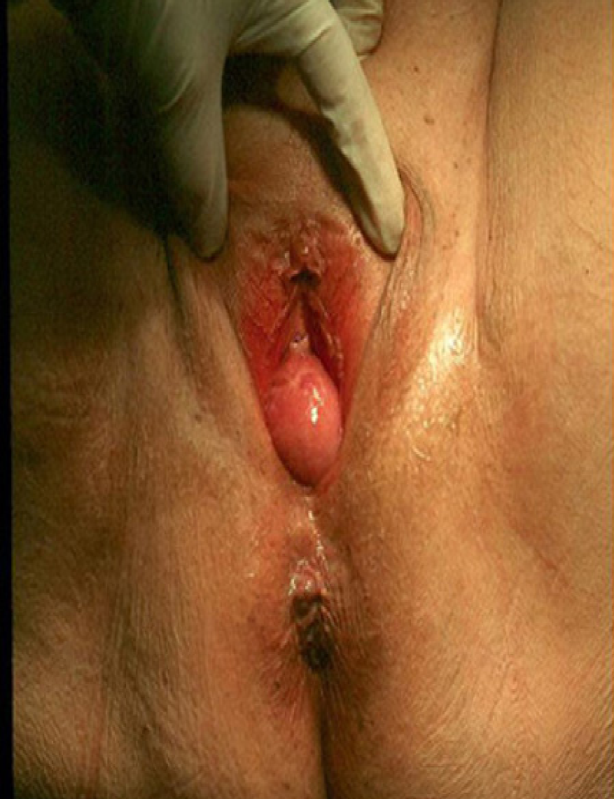
Evaluation: POP-Q Exam
Stage 2
Stage 3
Stage 4

Slide 50
POP Treatment Options
Conservative (PFMT with or without PT)
Non-surgical (pessary)
Surgical

Slide 51
Conservative Management
PFMT vs. control
  Improvement in symptoms
  17% had improvement by 1 stage in anatomy
  6 months of supervised PT best results
POPPY Trial
  PFMT vs lifestyle pamphlet
  Symptomatic Improvement at 12 months w PFMT, no difference in anatomy
PFMT in addition to surgery (OPTIMAL TRIAL)
  No added benefit of PFMT to vaginal prolapse surgery
Hagen et al . Cochrane Database Syst Rev. 2011
Hagen et al. Lancet. 2014
Barber et al JAMA. 2014
Notes:
Cochrane 2011 PFMT and POP
Randomized and quasi-randomized trials in women with pelvic organ prolapse that included a physical or lifestyle intervention in at least one arm of the trial. Six trials were included (however 4 had n < 25) and 2 trials had moderate to high risk of bias. Nonetheless, 4 trials compared PFMT for POP vs. control (n= 857) and two included women having surgery for POP vs. PFMT+ surgery (n=118 ). When comparing PFMT vs. control: 3 trials showed improvement in prolapse symptoms in the PFMT group. In terms of severity, 17% of patients had improvement by one stage of prolapse compared to the no PFMT group. The largest trial found the best PFMT regimen to be 6 months of supervised physical therapy. In general, most studies regarding POP and PFMT show an increase in strength of the pelvic floor muscles themselves, but have less rigorous and heterogeneous outcome measures which make the success of intervention for prolapse symptoms and anatomy more difficult to interpret.
POPPY trial, a parallel-group, multicenter, randomized controlled trial at 23 centers, compared women who received an individualized program of PFMT to women who were given a POP lifestyle pamphlet and no PFMT. At 12 months, women randomized to the PFMT group showed significant improvement of prolapse symptoms. Women in the PFMT group reported a lower POP symptom score from baseline at 12 months than the control group (3.77 vs. 2.09). However, no significant improvement in POPQ stage was noted between groups [8].
2014 OPTIMAL Barber et al largest multi-centered, randomized control trial uterosacral ligament suspension vs. sacrospinous ligament fixation (USLS vs. SSLF. In addition to comparing two POP procedures, participants were also randomized to the perioperative behavioral therapy with pelvic floor muscle training (BPMT) compared to usual care. Women in the perioperative BPMT arm underwent an individualized program that included visits between 2 and 4 weeks before surgery and additional postoperative visits (2, 4-6, 8, and 12 weeks after surgery). The results of the study showed no significant differences in the BPMT and usual care for 6 and 24- month primary outcomes (composite success)

Slide 52
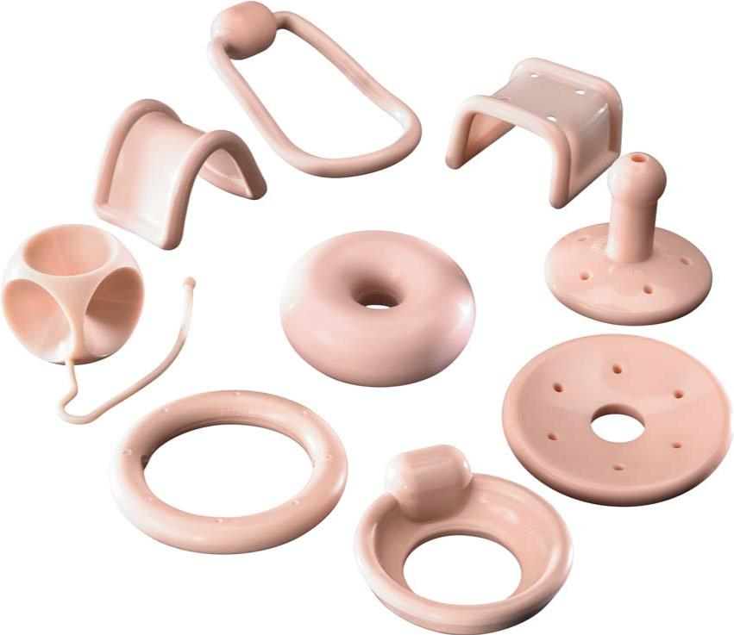
Nonsurgical Management: Pessaries
81% successfully fitted, 86% continued use, 12% minor complications (7% pain, 3% erosion 2% constipation)
Risk factors for unsuccessful placement:
  Short vaginal length (<6cm)
  Wide introitus (>4 fingerbreadths)
  Genital hiatus: total vaginal length ratio >0.8
  Age <65
  Lower POP-Q stage
coopersurgical.com
Lone et al. Int J Gynaecol Obstet. 2011
Clemons et al. Am J Obstet Gynecol. 2004
Geoffrion et al. Female Pelvic Med Reconstr Surg. 2013
Notes:
Success rates and continued rates from a 5 year prospective evaluation of 187 women (Lone et al )

Slide 53
Pessary Comparative Studies
Pessary vs. Pessary: PESSRI Study
  No clear benefit of one pessary over another
Pessary vs. PFME: (POPPS Trial)
  More improvement in POP symptoms with pessary
Pessary vs. Surgery
  All improve vaginal, bowel, urinary, and QOL symptoms; no difference between groups at 1 year
Cundiff et al Am J Obstet Gynecol. 2007
Panman et al Menopause 2016
Cheung et al Obstet Gynecol 2016
Lone et al. Int Urogynecol J. 2015
Notes:
Pessary vs. Pessary (ring:gelhorn)
The PESSRI trial randomized patients to ring and gellhorn pessaries. Women followed for a total of 3 months with interval visits at 1, 6, and 12 weeks. In addition to anatomical assessment (POP-Q, pelvic muscle grading, assessment for perineal descent, perineal reflexes, assessment for atrophy and erosions, wet prep), several validated questionnaires were also administered including the Pelvic Floor Distress Inventory (PFDI) and Pelvic Floor Impact Questionnaire (PFIQ). Overall, the study showed significant improvement in both pessary groups, with no clinically significant difference between the two pessaries
Pessary vs. Pelvic Floor Muscle Training
POPPS: Randomized women >55yo in the primary care setting (20 primary care practices) to either pelvic floor muscle training or pessary for 2 years. Primary outcomes for study include improvement in POP symptoms with secondary outcomes including quality of life, sexual function, POP-Q stage, pelvic floor muscle function, post-void residual, patients’ perception of improvement and costs
RESULTS: In women >55yo with symptomatic prolapse, there was significantly greater improvement in the prolapse symptoms in the pessary group, there was no significant difference between pessary treatment and PFMT in reducing other pelvic floor symptoms (overall PFDI score. Pessary treatment was preferable in the cost-effectiveness analysis. (Direct medical costs over the 2-year study were $309 and $437 per person for pessary treatment and PFMT, respectively.)
Cheung et al:
This was a parallel-group, single-blind, randomized controlled trial with 12 months of follow-up. N=276 women with symptomatic stage I to stage III POP were randomized to either pelvic floor exercises training vs. pelvic floor exercises training PLUS pessary. The primary outcome was the change of prolapse symptoms and QOL (Pelvic Floor Distress Inventory and Pelvic Floor Impact Questionnaires). Secondary outcomes included bothersome of prolapse symptoms, desired treatment, and any complications. RESULTS Mean improvement was higher in the pessary group.Complication rates were low and similar in both groups.
Pessary vs. Surgery
Lone et al. prospective study of pessaries compared to surgery n= 269, urogynecology clinic patients who chose pessary vs. surgery and followed up at 1 year using validated questionnaires. There was no statistically significant differences in improvement between the pessary and surgery group. Both groups reported improvement in vaginal, bowel, urinary and overall quality of life

Slide 54

POP Treatment: Surgical
Hysterectomy vs. uterine preservation
Obliterative vs. reconstructive
Vaginal vs. laparoscopic/robotic vs. open
Native tissue vs. graft augmentation
Notes:
Major Decision Tree categories, decision based upon patient factors (history, degree of prolapse, degree of bother, preferences), and Surgeon preference

Slide 55
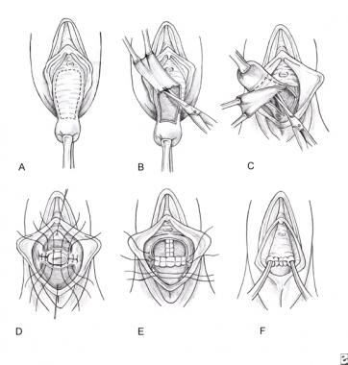
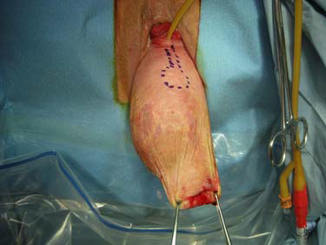
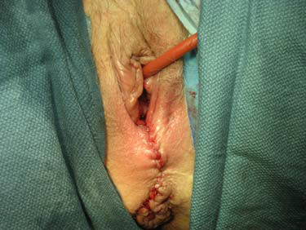
Obliterative Prolapse Repair
Frail, elderly, medically complex, advanced prolapse, does not desire future vaginal intercourse
High satisfaction >90%
Low complication rate
Improved body image, low regret
Hill et al Am J Obstet Gynecol 2016
Crisp et al. Am J Obstet Gynecol 2013
Crisp et al. Female Pelvic Med Reconstr Surg. 2016
Abbasy and Kenton Clin. Obstet Gynecol 2010
Adam et al http://emedicine.medscape.com/article/268258
Notes:
Complication Rates: Hill et al. Retrospective review of n= 245 The most common adverse event was urinary tract infection
occurring in 34.7% of subjects. Major adverse events were uncommon.There were no differences in event rates among the various procedures (Lefort vs. TVH + colpocleisis vs. colpectomy) following: patients undergoing concurrent vaginal hysterectomy had longer mean operative time (144 vs 108 vs 111 minutes, P< .0001), had higher estimated blood loss (253 vs 135 vs 146 mL, P < .0001).
Crisp et al (SGS FPRN) 90 patient prospective multicenter study. Colpocleisis improves body image and pelvic floor symptoms while giving patients a definitive surgical option that results in low regret and high satisfaction at both 6 weeks and 6 months.

Slide 56
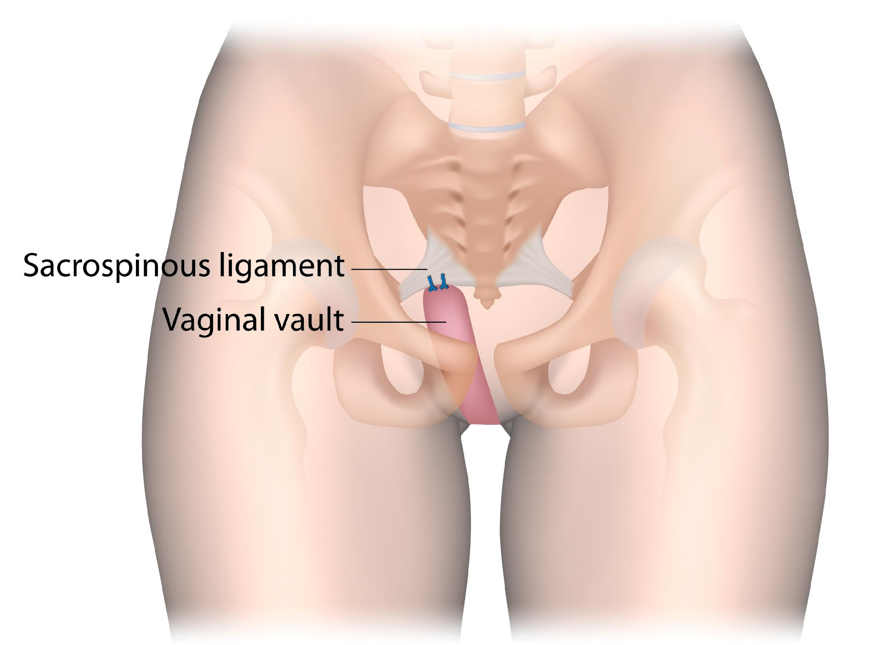
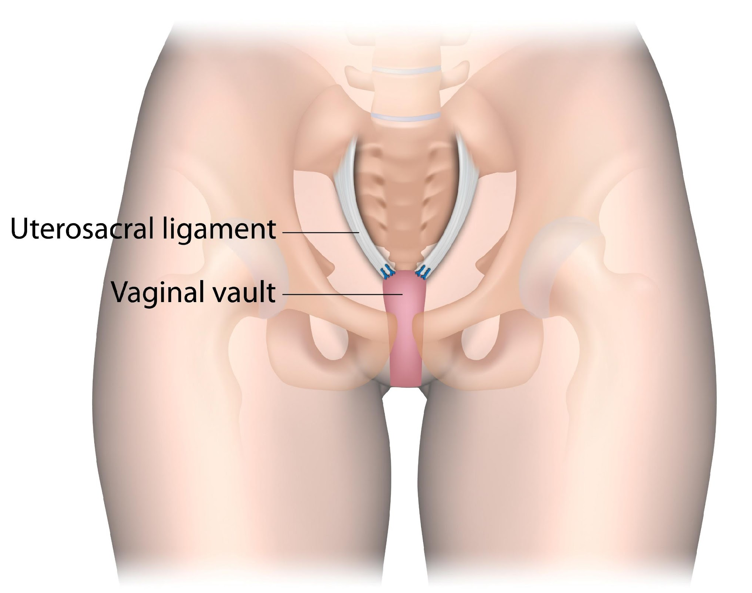
Native Tissue Reconstruction
Uterosacral/Sacrospinous Ligament Suspension
Anterior and Posterior Colporrhaphies
Sacrospinous Ligament Fixation
Uterosacral Ligament Suspension
Notes:
-Overall, success rates for native tissue prolapse repairs vary widely depending on definition
of success used, but generally, risk of prolapse beyond the hymen is 10% to 15%,
recurrent vaginal bulging symptoms are 10% to 20%, and need for reoperation is less
than 10% at 1 to 2 years after surgery.
- Uterosacral ligament suspension and sacrospinous ligament fixation are equally as effective
in the treatment of apical pelvic organ prolapse at 2 years postoperatively.
- Ultralateral suturing and standard midline plication are equally as effective in treatment of
anterior pelvic organ prolapse; the addition of absorbable mesh graft does not improve
outcomes.
- Transvaginal approach to rectocele repair is superior to transanal approach.
Midline plication is as effective as site-specific repair in treatment of symptomatic rectocele,
and addition of a porcine-derived biologic graft provides inferior results in the posterior
compartment.

Slide 57
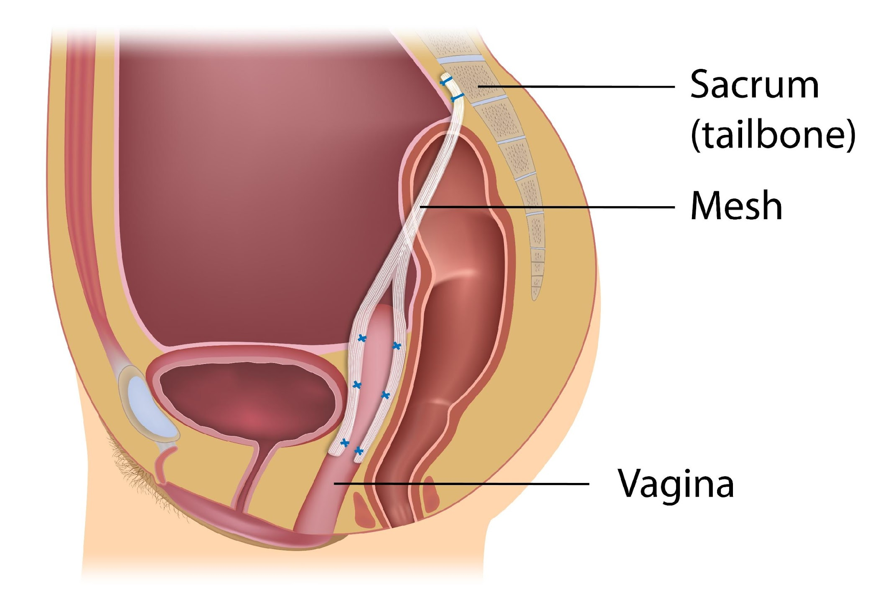
Sacrocolpopexy
Abdominal, laparoscopic, robotic routes
ECARE: 7-year outcomes, symptom success 70-75%, anatomic success 75%, Composite failure 34-48%, mesh erosion 10%
Nygaard et al. JAMA 2013
Notes:
ECARE

Slide 58
When to Send…
For a second set of eyes: (bumps, lumps, lesions)
For a second set of hands: surgery, procedural options, refractory or complicated patients
For diagnostic tools (urodynamics, cystoscopy, pessaries)
For questions: any time you are uncomfortable or want to escalate care
Insert card/contact info
Notes:
Bumps, lumps, lesions= vulvar dystrophy, urethral prolapse, urethral diverticulum, Fistulae, vaginal cysts

Slide 59
Resources for You and Your Patients
AUGS.org
VoicesforPFD.org
  A website and online community developed by AUGS to educate patients and caregivers about pelvic floor disorders, and to create a unique space for women to connect with other patients. (Videos, Apps, Printable Resources)

Slide 60

Questions?

Slide 61
References
1. Abbasy S, Kenton K. Obliterative procedures for pelvic organ prolapse. Clin Obstet Gynecol. 2010 Mar;53(1):86-98.
2. Albo ME, Richter HE, Brubaker L, Norton P, Kraus SR, Zimmern PE, et al. Burch colposuspension versus fascial sling to reduce urinary stress incontinence. N Engl J Med. 2007 May 24;356(21):2143-55.
3. Amundsen CL, Richter HE, Menefee SA, Komesu YM, Arya LA, Gregory WT, et al. OnabotulinumtoxinA vs Sacral Neuromodulation on Refractory Urgency Urinary Incontinence in Women: A Randomized Clinical Trial. JAMA. 2016 Oct 4;316(13):1366-74.
4. Ayeleke RO, Hay-Smith EJ, Omar MI. Pelvic floor muscle training added to another active treatment versus the same active treatment alone for urinary incontinence in women. Cochrane Database Syst Rev. 2015 Nov 3;(11):CD010551. doi(11):CD010551.
5. Barber MD, Brubaker L, Burgio KL, Richter HE, Nygaard I, Weidner AC, et al. Comparison of 2 transvaginal surgical approaches and perioperative behavioral therapy for apical vaginal prolapse: the OPTIMAL randomized trial. JAMA. 2014 Mar 12;311(10):1023-34.
6. Brown JS, Bradley CS, Subak LL, Richter HE, Kraus SR, Brubaker L, et al. The sensitivity and specificity of a simple test to distinguish between urge and stress urinary incontinence. Ann Intern Med. 2006 May 16;144(10):715-23.
7. Burgio KL, Kraus SR, Menefee S, Borello-France D, Corton M, Johnson HW, et al. Behavioral therapy to enable women with urge incontinence to discontinue drug treatment: a randomized trial. Ann Intern Med. 2008 Aug 5;149(3):161-9.
8. Cheung RY, Lee JH, Lee LL, Chung TK, Chan SS. Vaginal Pessary in Women With Symptomatic Pelvic Organ Prolapse: A Randomized Controlled Trial. Obstet Gynecol. 2016 Jul;128(1):73-80.
9.Clemons JL, Aguilar VC, Tillinghast TA, Jackson ND, Myers DL. Risk factors associated with an unsuccessful pessary fitting trial in women with pelvic organ prolapse. Am J Obstet Gynecol. 2004 Feb;190(2):345-50.
10. Crisp CC, Book NM, Cunkelman JA, Tieu AL, Pauls RN, Society of Gynecologic Surgeons' Fellows' Pelvic Research Network. Body Image, Regret, and Satisfaction 24 Weeks After Colpocleisis: A Multicenter Study. Female Pelvic Med Reconstr Surg. 2016 May-Jun;22(3):132-5.
11. Crisp CC, Book NM, Smith AL, Cunkelman JA, Mishan V, Treszezamsky AD, et al. Body image, regret, and satisfaction following colpocleisis. Am J Obstet Gynecol. 2013 Nov;209(5):473.e1,473.e7.
12. Cundiff GW, Amundsen CL, Bent AE, Coates KW, Schaffer JI, Strohbehn K, et al. The PESSRI study: symptom relief outcomes of a randomized crossover trial of the ring and Gellhorn pessaries. Am J Obstet Gynecol. 2007 Apr;196(4):405.e1,405.e8.
13. Dumoulin C, Hay-Smith EJ, Mac Habee-Seguin G. Pelvic floor muscle training versus no treatment, or inactive control treatments, for urinary incontinence in women. Cochrane Database Syst Rev. 2014 May 14;(5):CD005654. doi(5):CD005654.
14. Ellerkmann RM, et al. Correlation of symptoms with location and severity of pelvic organ prolapse. Am J Obstet Gynecol, 185(6), December 2001
15. Finazzi-Agro E, Petta F, Sciobica F, Pasqualetti P, Musco S, Bove P. Percutaneous tibial nerve stimulation effects on detrusor overactivity incontinence are not due to a placebo effect: a randomized, double-blind, placebo controlled trial. J Urol. 2010 Nov;184(5):2001-6.
16. Geoffrion R, Zhang T, Lee T, Cundiff GW. Clinical characteristics associated with unsuccessful pessary fitting outcomes. Female Pelvic Med Reconstr Surg. 2013 Nov-Dec;19(6):339-45.

Slide 62
References
17. Gormley EA, et al. American Urological Association (AUA) Guideline: Diagnosis and Treatment of Overactive Bladder (non-Neurogenic) in Adults: AUA/SUFU Guideline. May 2012
18. Hagen S, Stark D. Conservative prevention and management of pelvic organ prolapse in women. Cochrane Database Syst Rev. 2011 Dec 7;(12):CD003882. doi(12):CD003882.
19. Hagen S, Stark D, Glazener C, Dickson S, Barry S, Elders A, et al. Individualised pelvic floor muscle training in women with pelvic organ prolapse (POPPY): a multicentre randomised controlled trial. Lancet. 2014 Mar 1;383(9919):796-806.
20. Imamura M, Williams K, Wells M, McGrother C. Lifestyle interventions for the treatment of urinary incontinence in adults. Cochrane Database Syst Rev. 2015 Dec 2;(12):CD003505. doi(12):CD003505.
21. Lawrence, JM, et al. Prevalence and Co-Occurrence of Pelvic Floor Disorders in Community-Dwelling Women. Obstetrics & Gynecology. 111(3), March 2008
22. Lone F, Thakar R, Sultan AH. One-year prospective comparison of vaginal pessaries and surgery for pelvic organ prolapse using the validated ICIQ-VS and ICIQ-UI (SF) questionnaires. Int Urogynecol J. 2015 Sep;26(9):1305-12.
23. Lone F, Thakar R, Sultan AH, Karamalis G. A 5-year prospective study of vaginal pessary use for pelvic organ prolapse. Int J Gynaecol Obstet. 2011 Jul;114(1):56-9.
24. National Institute of Child Health and Human Development. Pelvic Floor Disorders, www.nichd.nih.gov/health/topics/pelvicfloor/conditioninfo/Pages/default.aspx
25. National Institute of Diabetes and Digestive and Kidney Diseases. Urinary Incontinence in Women, kidney.niddk.nih.gov/KUDiseases/pubs/uiwomen
26. Norton, P A et al. Distress and Delay Associated With Urinary Incontinence. BMJ, 297(5), November 1988
27. Nygaard I, Barber MD, Burgio, KL, et al. Prevalence of Symptomatic Pelvic Floor Disorders in US Women. JAMA. 2008;300(11):1311-1316
28. Nygaard I, Brubaker L, Zyczynski HM, Cundiff G, Richter H, Gantz M, et al. Long-term outcomes following abdominal sacrocolpopexy for pelvic organ prolapse. JAMA. 2013 May 15;309(19):2016-24.
29. Shah D, Badlani G. Treatment of overactive bladder and incontinence in the elderly. Rev Urol. 2002;4 Suppl 4:S38-S43.
30. Siff LN, Barber MD. Native Tissue Prolapse Repairs: Comparative Effectiveness Trials. Obstet Gynecol Clin North Am. 2016 Mar;43(1):69-81.
31. Staskin DR. Overactive bladder in the elderly: a guide to pharmacological management. Drugs Aging. 2005;22(12):1013-1028.
32. Stoddart H, Donovan J, Whitley E, Sharp D, Harvey I. Urinary incontinence in older people in the community: a neglected problem? Br J Gen Pract. 2001;51(468):548-552.
33. Visco AG, Brubaker L, Richter HE, Nygaard I, Paraiso MF, Menefee SA, et al. Anticholinergic therapy vs. onabotulinumtoxina for urgency urinary incontinence. N Engl J Med. 2012 Nov 8;367(19):1803-13.
34. Voytas J. The role of geriatricians and family practitioners in the treatment of overactive bladder and incontinence. Rev Urol. 2002;4 Suppl 4:S44-S49.
35. Walters, MD, Karram, MM Urogynecology and Reconstructive Pelvic Surgery, 4t^{h} ed. Philadelphia, PA: ELSEVIER; 2015.
36. Whitcomb EL, Subak LL. Effect of weight loss on urinary incontinence in women. Open Access J Urol. Aug 1 2011; 3: 123–132
37. Wu JM, Vaughan CP, Goode PS, et al. Prevalence and trends of symptomatic pelvic floor disorders in U.S. Women. Obstet Gynecol 2014;123:141

